Slide 1
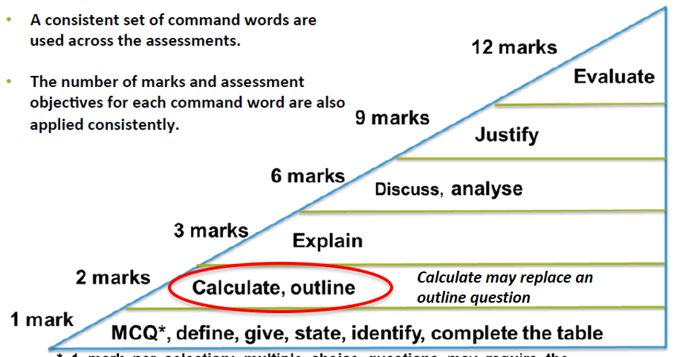
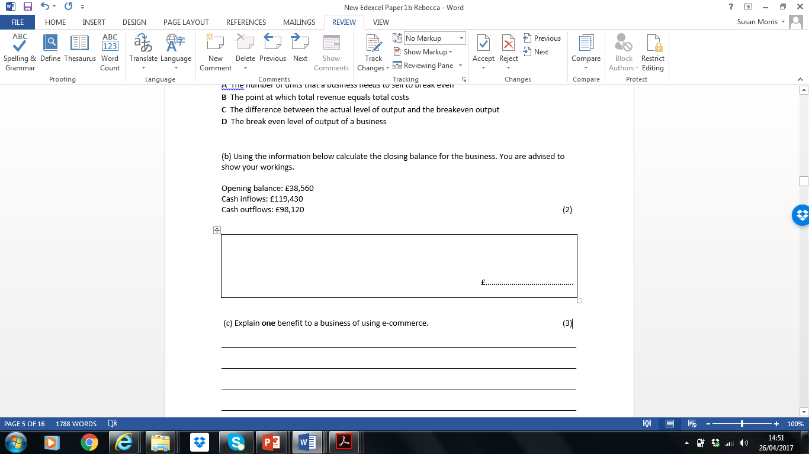
MULTIPLE CHOICE QUESTIONS
1 mark per answer
Ensure a cross is put clearly in the appropriate
box for MCQs
If you change your mind, put a line through the box and mark the new answer with a cross
If you do change your mind, refer back to the
instructions at the start of Section A to ensure
you are following them precisely; the key is to
make sure your answer is clear
GIVE/STATE/
IDENTIFY
1 mark
You will gain 1 mark for each different point you make
DO NOT write a lengthy sentence for each point you make
Make sure your points are different
OUTLINE
2 marks
Found in Sections B and C
For 2 marks you need to make one point and develop it
Context needed in Section B and C
Use of 1 connective to explain the point – how why
Note: A list of points with no development will only score 1 mark
Key connectives:
which means…..
because
therefore
Explain
3 marks
Only in Section A
Always 3 marks – assessing knowledge and understanding only
No context required
Need to use 2 connectives – no full stop until the end of the sentence.
6 explain questions per paper – 20% of the marks for each paper
Key connectives:
which means….
because…
this leads to…
COMPLETE THE TABLE
1 mark per answer
Ensure the figures are clear and are entered in the appropriate box(es)
Read the question carefully; if two figures are asked for then ensure that two figures are
included
DISCUSS
6 marks
Always 6 marks – assessing understanding and analysis only
No context
How to answer it:
MUST HAVE 5 CONNECTIVES IN THE ANSWER
1 point made with 4 connectives
OR
2 points – one with 3 connectives and one with 2 connectives
2 points do not need to be an advantage and a disadvantage, just 2 relevant points
Key connectives
…however…therefore…
…is important because…
…is more/less important because…
…is most important because…the consequence of this…
CALCULATE
2 marks
Found in all 3 sections
1 Mark for technique, 1 mark for correct answer.
NO MARKS FOR FORMULA
ANSWER MUST BE ON THE ANSWER LINE FOR THE MARK

Slide 2
ANALYSE
6 marks
Two “Analyse” questions will be found in the paper, only in Section B
SAME STRUCTURE AS A DISCUSS ANSWER – BUT MUST BE IN CONTEXT OF THE CASE STUDY
• A variety of “Analyse” questions will be found in the exams
e.g. “Analyse the impact…”, “Analyse
the benefit…”, “Analyse the drawback…”
No definition
Ideally the points should be taken from the extract
The interconnected strands should refer to the
context throughout and demonstrate a logical chain of reasoning
Key connectives
…however…therefore…
…is important because…
…is more/less important because…
…is most important because…the consequence of this…
JUSTIFY 9 marks
EVALUATE 12 marks
The difference between these questions is :
9 mark will give you two options
12 mark you have to create appropriate realistic options for the business
Structure your answer as follows:
Paragraph 1: Give a mini judgement, one sentence is sufficient : “Name the business” should go with the option of……………
Paragraph 2: Identify a positive & negative of the option you have chosen, explain with connectives referring to the case study.
The option of ………… would be good for “name the business” because…………. This option could have the positive effects such as…………. therefore leading to……….. for “name the business”. It could result in ……….. because………. However the option of ………………… could have consequences for “name the business” because…………. This option could have the negative effects such as……therefore leading to………….. for “name the business”. It could result in ……….. because……….
Paragraph 3: Identify a positive & negative of the other option, explain with connectives referring to the case study.
The option of ……… would be good for “name the business” because……………. This option could have the positive effects such as……………. therefore leading to……………….. for “name the business”. It could result in ……….. because………. However the option of ………… could have consequences for “name the business” because……………. This option could have the negative effects such as……………. therefore leading to…………. for “name the business”. It could result in ……….. because……….
Paragraph 4: Justify why your option is the best and why, remember to use key connective (however…therefore……is important because……is more/less important because……is most important because…the consequence of this…)
The best option for “name the business” is to ………………………... If “name the business” go with option it could lead to……………. In the short term, it could lead to ………………. which has many positive impacts such as……………………………. In the long term, it could result in ………………. and…………...The option of……………. for “name the business” is better than …………… because……………. However it may depend on……….. (think carefully about the situation of the business, its finances, its aims when making this decision) Overall “name the business” should go with…………….
Convince the examiner your judgement/choice is correct for the business; write a nice, detailed chunky paragraph here!
Connectives & Phrases
which means…..
because
Therefore
This could lead to…….
On the other hand
Likewise
Ultimately
To conclude
Further more….
……however…therefore…
…is important because…
…is more/less important because…
is most important because…the consequence
It could depend on…….
Arguably……
Subsequently
Similarly
As long as……..
Such as
Overall
……could have many consequences such as….
As a result of this………
However it could depend on……
As long as………was taken into consideration
..will effect many areas of the business such as
This will impact on customers because
This will effect their competitors as they…
....could impact on staff motivation because…….
Thus leading to…..
…..their target market may decide to……….
At first it may seem like the best option however……
When all factors are considered…………

