Slide 1

The difference between a comet, meteor, asteroid and a meteorite
By Rachael Petersen

Slide 2

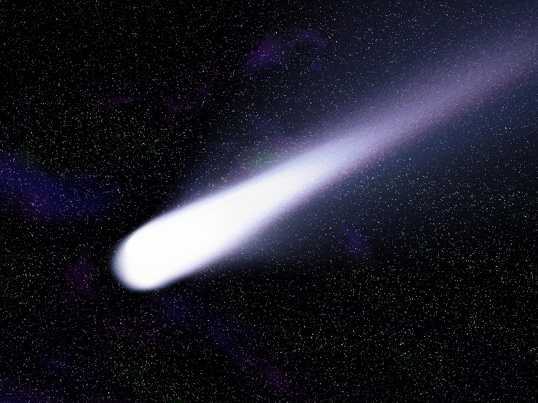
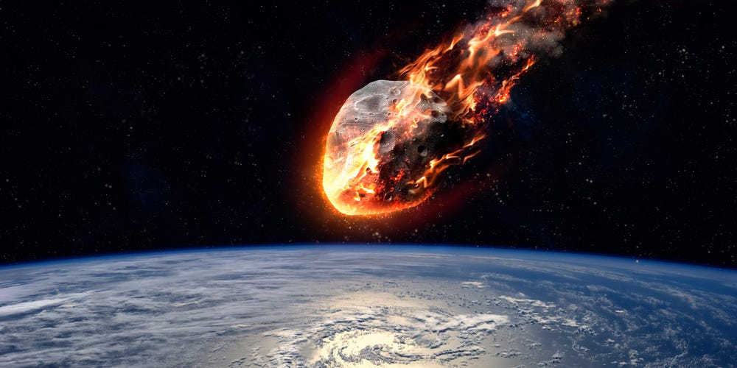
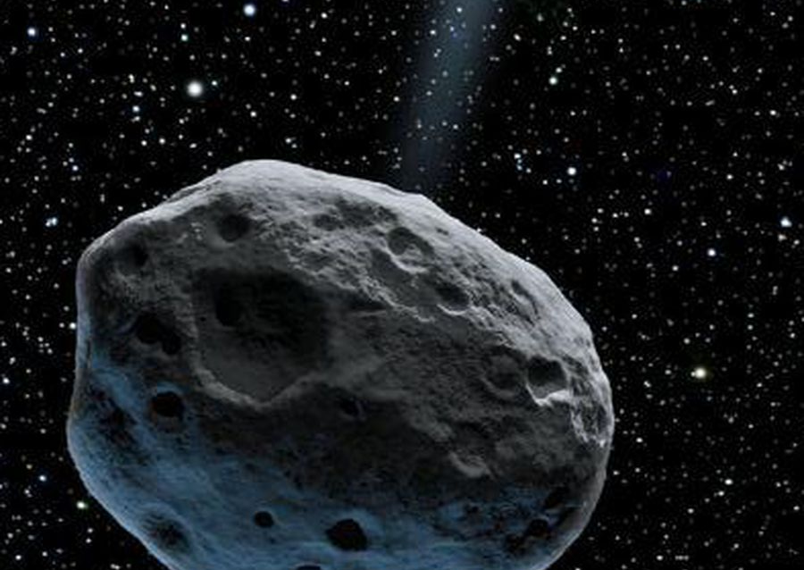
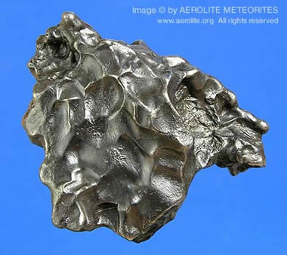
What's the difference?
A comet is a body of ice, dust and rocks and orbits the Sun if a comet gets too close to something hot, the icy shell will sublimate. An asteroids are small objects that orbit the Sun. A meteor is a small metallic body in our solar system it is smaller than an asteroid but can be the total size of 1 meter. A meteorite is a solid piece of debris from an object, such as a comet, asteroid, or meteoroid. The difference is that a comet has an icy shell and an asteroid doesn’t, a meteor doesn’t hit Earth’s land and a meteorite does.

