Slide 1
Use powerpoint in ppt mode, as though you were in a lesson.
Read the handout about different types of microscope.
Attempt to label the microscope diagram
Use the handout and any other resources you can access to complete the comparison table on slide 3
Attempt the exam questions and mark your answers.

Slide 2
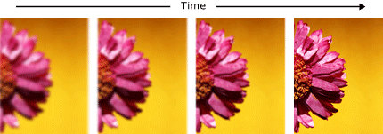
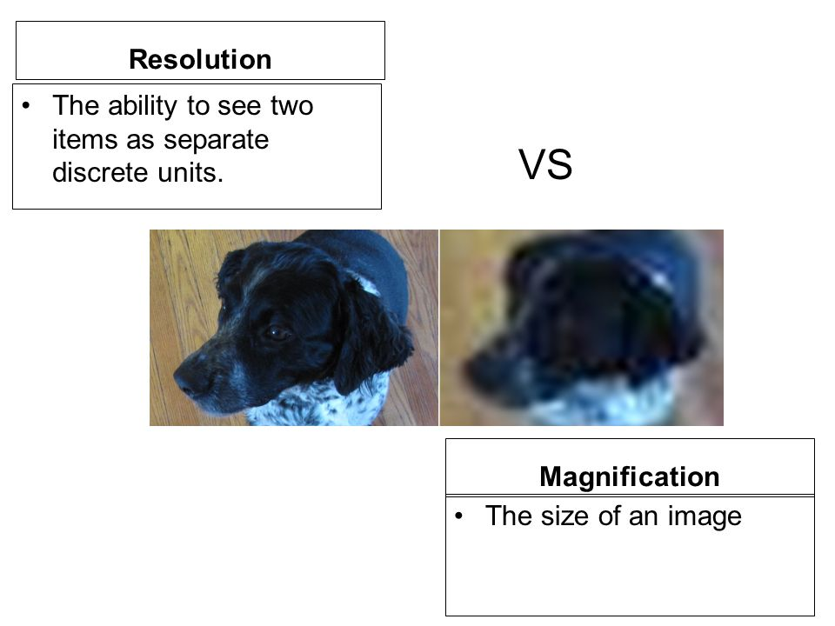
The two key concepts that you must understand about microscopes are resolution and magnification
Define the concepts of magnification and resolution.
Resolution
The ability to see two items as separate discrete units
Increasing…
Magnification
How many times bigger the image is when compared to the original image

Slide 3
Feature | Light Microscope | Electron Microscope
Price?
Operating costs?
Portability?
Sample preparation time / complexity?
Distortion of prepared material
Does it require a vacuum?
Colour of sample in image?
Maximum magnification?
Dead or living specimens?
Does it use stains? Give examples.

Slide 4
Feature | Light Microscope | Electron Microscope
Price? | Cheap to purchase (£100 – 500) | Expensive to buy (over £ 1 000 000).
Operating costs? | Cheap to operate. | Expensive to produce electron beam.
Portability? | Small and portable. | Large and requires special rooms.
Sample preparation time / complexity? | Simple and easy sample preparation. | Lengthy and complex sample prep.
Distortion of prepared material | Material rarely distorted by preparation. | Preparation distorts material.
Does it require a vacuum? | Vacuum is not required. | Vacuum is required.
Colour of sample in image? | Natural colour of sample maintained. | All images in black and white.
Maximum magnification? | Magnifies objects only up to 2000 times | Magnifies over 500 000 times.
Dead or living specimens? | Specimens can be living or dead | Specimens are dead, as they must be fixed in plastic and viewed in a vacuum
Does it use stains? Give examples. | Stains are often needed to make the cells visible | The electron beam can damage specimens and they must be stained with an electron-dense chemical (usually heavy metals like osmium, lead or gold).

Slide 5
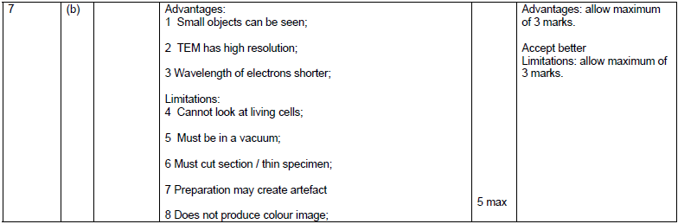
Scientists use optical microscopes and transmission electron microscopes (TEMs) to investigate cell structure. Explain the advantages and the limitations of using a TEM to investigate cell structure [5 marks]

Slide 6
Contrast how an optical microscope and a transmission electron microscope work and contrast the limitations of their use when studying cells. (6 marks)
M1. (a) 1. TEM use electrons and optical use light;
2. TEM allows a greater resolution;
3. (So with TEM) smaller organelles / named cell structure can be observed
OR
greater detail in organelles / named cell structure can be observed;
4. TEM view only dead / dehydrated specimens and optical (can) view live specimens;
5. TEM does not show colour and optical (can);
6. TEM requires thinner specimens;
7. TEM requires a more complex/time consuming preparation;
8. TEM focuses using magnets and optical uses (glass) lenses;
3. ‘clearer’ is not equivalent to ‘detail’
4. Accept ‘Only optical can view live specimens’
5. Accept ‘Only optical can show colour’
7. Accept ‘TEM requires a more difficult preparation’
Ignore references to artefacts
6 max
[6]

