Slide 1
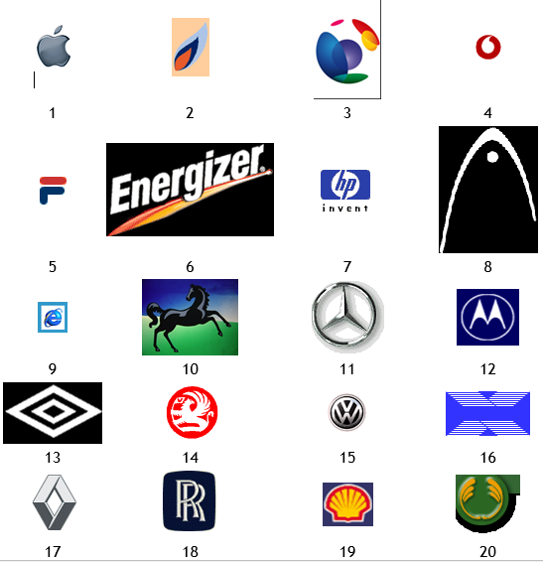
Name the logo – complete the sheet

Slide 2
Applied General Business Studies
Sixth form options

Slide 3
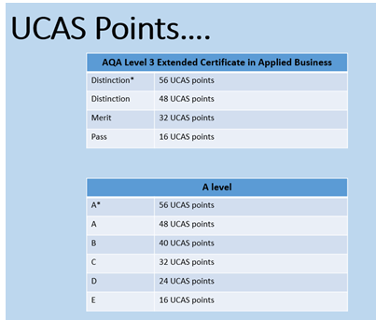

Slide 4
Overview
In 2 years – 6 units to be completed
6 Compulsory units from the exam board
Year 12
Year 13
3 units with 2 teachers
Unit 1 – Financial Planning - Exam in January
Unit 2 – Business Dynamics Coursework - we mark
Unit 3 – Entrepreneurial Opportunities Coursework – AQA mark
3 units with 2 teachers
Unit 4 – Managing and leading Exam
Unit 5 – Developing a proposal
Coursework – we mark
Unit 8 –Marketing Communications – we mark

Slide 5
This week, your lessons will cover
Unit 1 – Financial Planning -
Unit 2 – Business Dynamics
Unit 4 – Managing and Leading

Slide 6
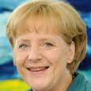

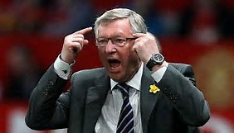
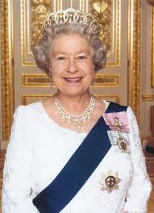
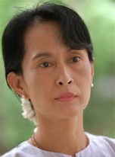
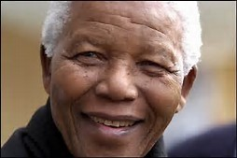
Who are these people and what do they have in common?

Slide 7
Leadership
To understand the different leadership styles
Analyse the impact of style on motivation
Evaluate how leadership style may change

Slide 8
What do leaders do?

Slide 9
What do leaders do?
Creating an inspiring business vision.
Motivating and inspiring people to believe in the vision.
Managing the delivery of the vision.
Building effective teams to implement the vision.
Adapting the business vision due to events arising from risk and uncertainty.
Recognise skills in the business
Make use of human talent
Set objectives and direction
Set standards for the business eg commitment
Help shape the culture of the business
Role Models

Slide 10
Tannenbaum and Schmidt
Continuum of Leadership
Watch this clip and answer the questions on the slides following:
Which leadership style is which?
Manager-centered leadership
Subordinate-centered leadership
Manager makes decision & tells staff about it
Manager sells decision to his staff
Manager presents ideas & invites questions from staff
Manager presents tentative decision subject to change
Manager presents problem; gets suggestions, then makes the decision
Manager asks group to make decision within the limits he/she sets
Manager allows team to develop options & decide on actions defined by manager
Tell
Sell
Consult
Joins
Notes:
There are 7 levels to the tannenbaum and schmidt model
Level 1 – 4 manager has authority (autocratic)
4& 5 managers consult (democratic)
6 & 7 managers delegate (Paternalist)

Slide 11
Tells
Manager makes decision and announces it
An autocratic style in which the leader gives specific instructions and monitors staff closely is most useful when the team cannot tackle the task unaided, is unwilling, new or suffered a previous leader who allowed standards to deteriorate. It is the style most people accept in a crisis.
For this style to work well you need to:
Be clear and precise about standards, performance targets and expectations;
Give detailed instructions;
Monitor key performance indicators closely;
Use frequent feedback to modify behaviour;
Help people over learning problems while being firm about standards.
From video – Which Manager is Tells?________________________________________
Affect on motivation of staff…

Slide 12
Sells
Manager makes decision and then "sells" decision
A persuasive style, in which the leader gives clear direction and supervises closely but also explains decisions, encourages suggestions and supports progress. It is most useful when motivation is lacking. It is also the best style where a task is non-negotiable but where the team's motivation is vital to achieve the results required.
For this style to work you need to:
Develop team skills, monitoring how those skills are implemented;
Spend time with each individual addressing standards, skills and motivation;
Monitor closely and be directive to keep performance to agreed standards;
Listen to the team's feelings but stand your ground in relation to the goal;
Reward positive behaviour.
From video – Which Manager is Sells?_______________________________________
Affect on motivation of staff…

Slide 13
Consult
Manager presents ideas and invites questions
Manager presents tentative decision subject to change
Manager presents problem, get suggestions, makes decision
This is a collaborative style in which the leader discusses the task and listens to the team's ideas, taking them into account as he or she makes the key decisions. It is most useful when the team has sufficient skills and competence to make a contribution but where the leader feels a need to retain control. That need can result from an imbalance between the team's competence and the risk involved in the task.
For this style to work you need to:
Focus on morale and team spirit;
Encourage participation, straight comment and feedback.
Specify objectives but let the team discuss how to achieve them;
Explain fully, and encourage 'buy-in' to major decisions while minimising directives and suggestions from yourself, except in exceptional circumstances.
From video – Which Manager is Consult?_________________________________________
Affect on motivation of staff…

Slide 14
Participate/Join
Manager defines limits; asks group to make decision
Manager permits subordinate to function within limits defined by superior
A facilitating style in which the leader allows the team maximum responsibility, this is most useful when the team is competent and has a positive attitude towards the task. You can let them get on with it and use this style as an important part of their development.
For this style to work you need to:
Act as a resource that the team can call on when needed;
Delegate increased responsibilities;
Allow team members to manage themselves once you have agreed clear objectives - allow them to administer day-to-day monitoring and control;
Represent the team to others, when necessary tackling anything that interferes with their performance.
From video – Which Manager is Participate/Join?_______________________________
Affect on motivation of staff…

Slide 15
How can different styles affect employee motivation?
Analyse the impacts – positive and negative, short and long-term affect?
Write your ideas on A3 paper to make a poster

