Slide 1
Try to get as close as you can to the target number using these six numbers:
100 50 75 5 10 7
Target Number: 423
You can't use the same number more than once.
Only plus, minus, times and divide are allowed.

Slide 2
Overview
In 2 years – 6 units to be completed
5 Compulsory units from the exam board
1 optional
Year 13
Year 12
3 units with 2 teachers
Unit 1 – Financial Planning - Exam in January
Unit 2 – Business Dynamics Coursework - we mark
Unit 3 – Entrepreneurial Opportunities Coursework – AQA mark
3 units with 2 teachers
Unit 4 – Managing and leading Exam
Unit 5 – Developing a proposal
Coursework – we mark
Unit 7 or 8 – Organising an event or Marketing Communications – we mark

Slide 3

Welcome to Business Studies
By the end of this lesson you should understand:
To identify the different costs that a business incurs
Explain how a business calculates profits/loss
Calculate a profit and loss using formula
Notes:
This is linked to Unit 1 – Financial planning, this will be examined in January 2018

Slide 4
Learn the term “Profit”
Sales Revenue – Total costs
= Profit/loss

Slide 5
Glastonbury
From the video (click on the picture) take down 5 keys points – considering that we are discussing profit and loss.
1.
2.
3.
4.
5.

Slide 6
Task 1 : Decide what is meant by Fixed or Variable costs
Task 2: Create a list of at least 10 costs that Michael Eavis may have incurred when creating Glastonbury.
Variable Costs
Fixed Costs

Slide 7
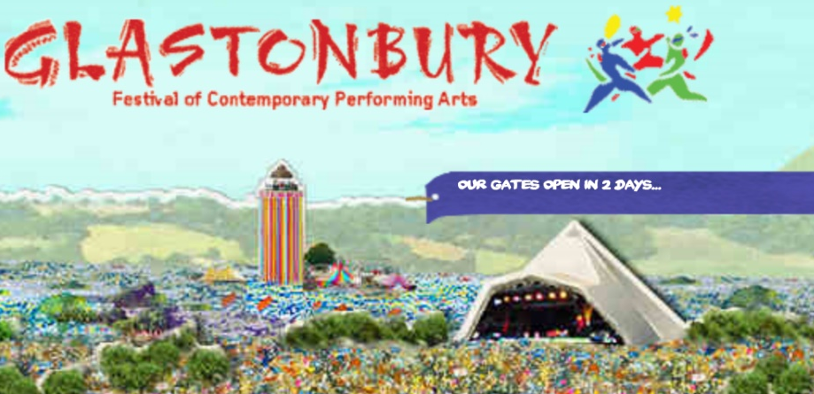
For Glastonbury Music Festival
What are fixed costs?
What are variable costs?
Monthly rent
Marketing costs
Heating and Lighting
Water
Bands
Salary
Rental of tents
Catering
Wages
PPC advertising
Petrol
Notes:
Using the case study

Slide 8
Glastonbury financial calculations
Calculate the total cost for the company per month
(fixed + variable = total cost)
Calculate the monthly sales revenue
Calculate the monthly profit or loss
Notes:
Worksheet in shared area

Slide 9
Glastonbury has sold 135,000 tickets which cost £205 each, everyone attending must pay £25 to camp on their site.
Michael Eavis must pay £1450 for the rent on his farm, which he does not own.
Please see the table of costs
Expenditure | £
Rent | 1, 450
Electricity | 65,000
Wage Oxfam | 2,000,000
Marketing costs | 200,000
Water | 260,000
Fuel and tent hire | 8,500,000
Hire of Acts | 10,470500
Looking at the costs in the table above which costs are fixed or variable, write in the table below.
Fixed costs | Variable

Slide 10
Using the information from the previous slide, answer the questions below, showing your working:
Calculate the total cost for Glastonbury
Calculate the monthly sales revenue
Calculate the monthly profit or loss for Glastonbury

Slide 11


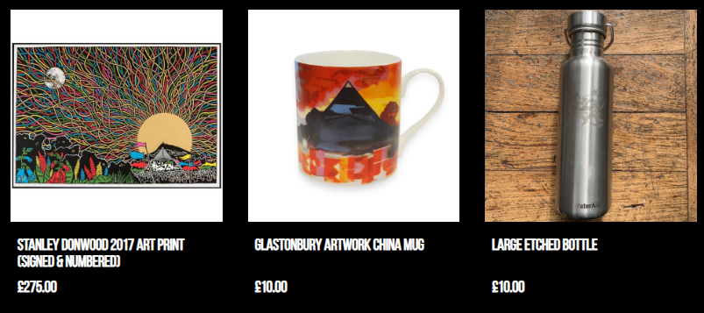
It’s all about the merch..
To make some more cash Michael Eavis has decided to investigate The T-shirt Manufacturer Ltd to see if the company is reliable and profitable to complete the order for Glastonbury 2019
Notes:
Complete the task worksheet in shared area

Slide 12
The T-Shirt Manufacturer Ltd
A T-shirt manufacturer produces and sells 1 000 T-Shirts every month for £20 each. The company’s production costs are:
Looking at the costs in the table above which costs are fixed or variable, write in the table below.
Expenditure | £
Monthly rent | 1, 450
Cloth and Cotton per T-shirt | 8
Wage cost per T-shirt | 4
Marketing costs per month | 600
Heating and Lighting per month | 350
Fixed costs | Variable
Using the information above, answer the questions below, showing your working:
Calculate the total cost for the company per month (remember fixed + variable = total cost)
Calculate the monthly sales revenue
Calculate the monthly profit or loss for The T-shirt manufacturer
Suppose that The T-shirt Manufacturer, buyer request 500 additional T-shirts per month and are willing to pay £22 per T-shirt. To fulfil this order, wage costs rise to £10 per T-shirt because of overtime. Calculate the effect on profits
Why might The T-shirt manufacturer find that profits do not rise as a result of accepting the extra order? Explain your answer.

Slide 13
So do you understand…..
How a business makes profit
The types of costs in a business
How to calculate profit or loss
Evaluate which has a greater impact on a business’ profit: sales price or costs.

Slide 14
Key Terms
Sales revenue – the money received from selling goods /services
Variable costs - costs of sales eg cost of raw materials and the wages of those employees directly involved in production of goods
Fixed costs – costs of overheads and expenses that have to be paid even if nothing is sold
Total costs – Fixed plus Variable costs
Gross profit – sales revenue less the variable costs, or profit before fixed costs are deducted
Net profit – this Is the profit after variable and fixed costs have been deducted
Loss – costs have exceeded sales revenue

Slide 15
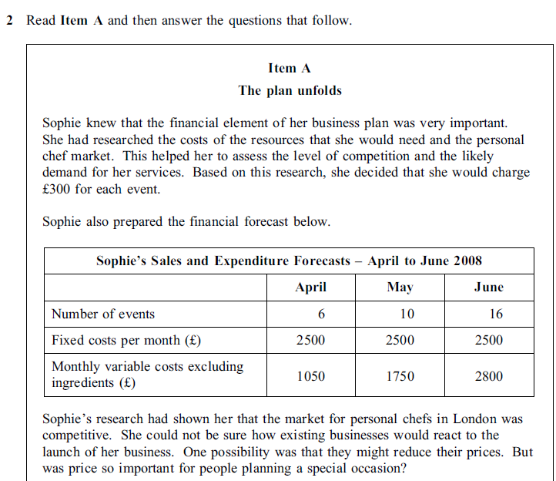

Slide 16
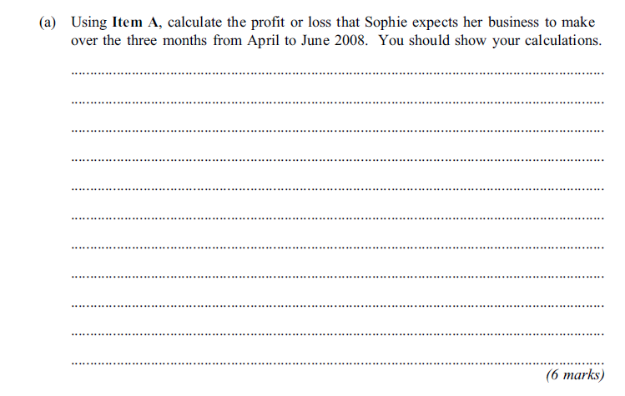
Exam Question
Command word.
Each step that you take.

Slide 17
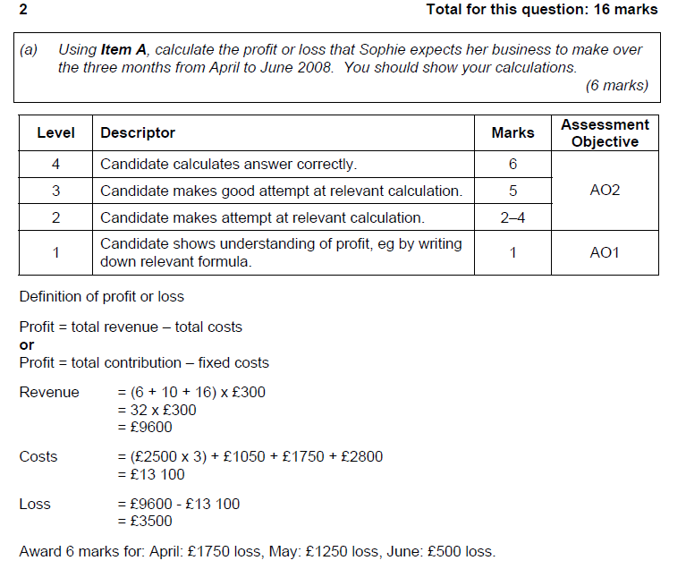
Mark Scheme

