Slide 1
On a Mission – name the business….
Statement | Business
To be one of the world’s leading producers and providers of entertainment and information
To be our customers’ favourite place and way to eat and drink.
It’s our goal to be Earth’s most customer-centric company, where customers can find and discover anything online.
Inspire and develop the builders of tomorrow.
To refresh the world in mind, body and spirit.
To be the leading sports brand in the world
To bring inspiration and innovation to every athlete in the world
We are on the face of earth to make great products.
To inspire and nurture the human spirit – one person, one cup and one neighbourhood at a time.
Serving Britain’s shoppers a little better, every day
Have a guess…

Slide 2
Unit 2 – Business Dynamics
Coursework unit
Internally Assessed

Slide 3
Lesson Objective
Introduction to unit 2 – Business Dynamics
To identify the purpose of a mission statement
Explain why a business such as Merlin Entertainments have mission statements
Analyse the benefits of having a mission statement to help aid the aims of Merlin Entertainments

Slide 4
On a Mission
Statement | Business
To be one of the world’s leading producers and providers of entertainment and information
To be our customers’ favourite place and way to eat and drink.
It’s our goal to be Earth’s most customer-centric company, where customers can find and discover anything online.
Inspire and develop the builders of tomorrow.
To refresh the world in mind, body and spirit.
To be the leading sports brand in the world
To bring inspiration and innovation to every athlete in the world
We are on the face of earth to make great products.
To inspire and nurture the human spirit – one person, one cup and one neighbourhood at a time.
Serving Britain’s shoppers a little better, every day
Disney
Mcdonalds
Amazon
Lego
Coca Cola
Adidas
Nike
Apple
Starbucks
Tesco

Slide 5
The Mission or Vision Statement is…
The overriding purpose of the business
The reason for its existence
A strategic perspective
Supports the stated “vision” for the future

Slide 6
A Mission/Vision Statement is NOT intended to be:
Statement of goals or objectives
Statement of core values
A statement of how the business intends to compete or position itself in the market

Slide 7
Mission and the Hierarchy of Objectives
Where do it fit?
Aim
Mission
Corporate Objectives
Functional Objectives
Business Unit / Individual Targets

Slide 8
Key Audiences for a Mission/vision Statement
Employees
Customers
Investors
Society

Slide 9
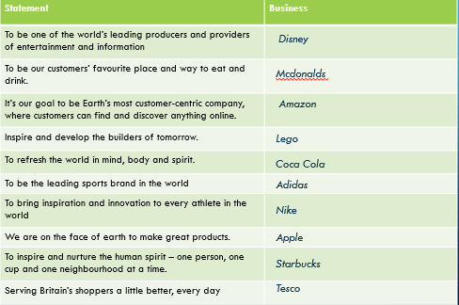
What Makes a Good Mission?
A clear sense of business purpose
Excites, inspires, motivates & guides
Easy to understand and remember
Differentiates business from competitors
For all stakeholders - not just shareholders and managers
Thinking about these mission statements;
What makes them good?
Do they help inform the various stakeholders?
Do they support the aims of the business?

Slide 10
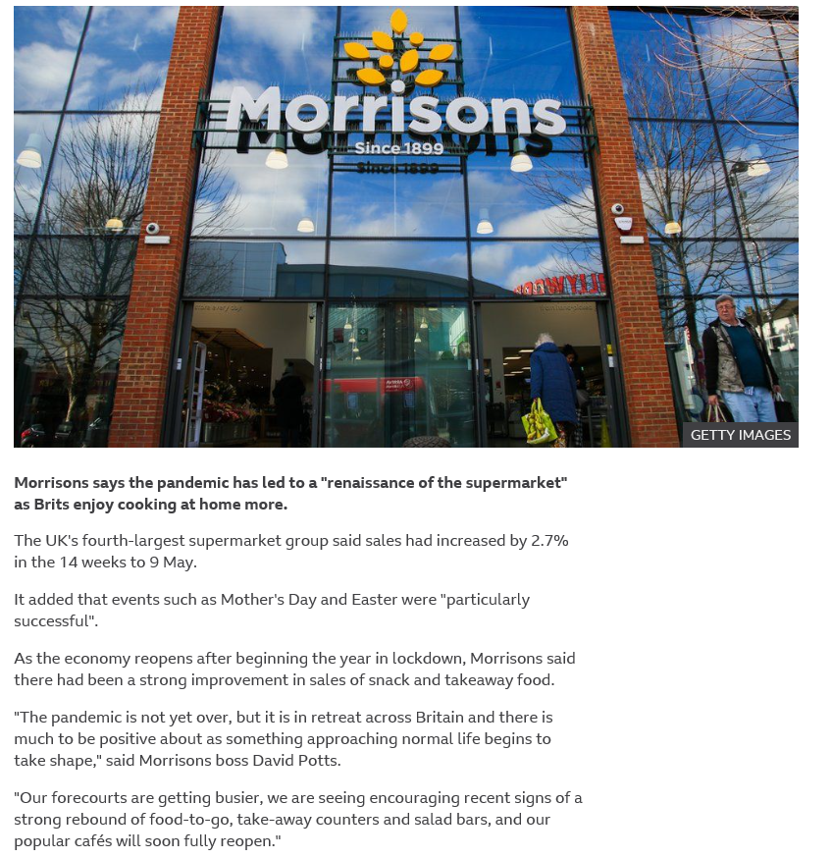
Read the article https://www.bbc.co.uk/news/business-57067802
Identify impacts this news will have on Morrisons
How might the news affect Morrisons’ business vision?

Slide 11
Assignment – Focus on MOrrisons
Read through the assignment
Task 1 – Vision statement – research what you think the vision statement and business aims for Morrisons are – write this out and keep for use in lesson
Explain what the benefits to the company are of having a vision and aims
Notes:
Click on Morrisons to go to ‘Company’ page

Slide 12
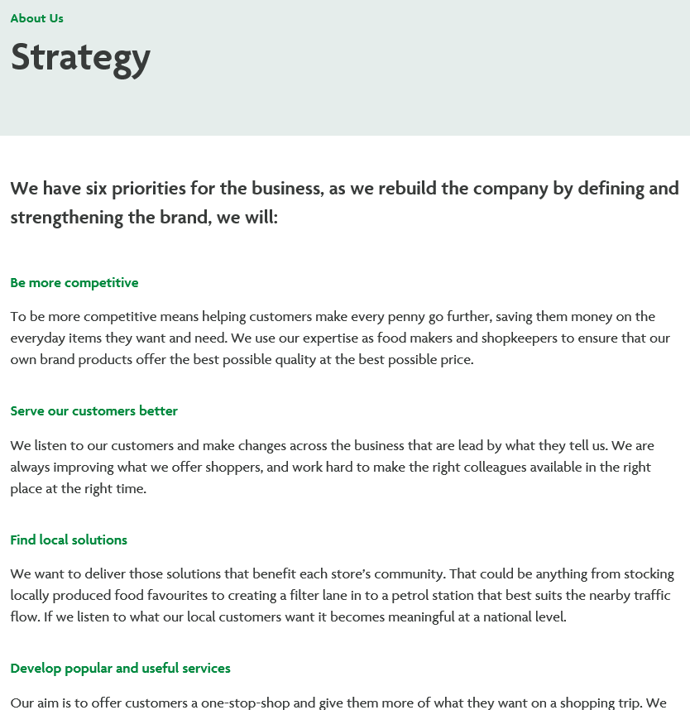
What did you discover?
What are the benefits to Morrisons of having this strategy?
Why are there 6 priorities and how well do you think Morrisons are working toward these priorities?

