Slide 1

A Level Literature

Slide 2
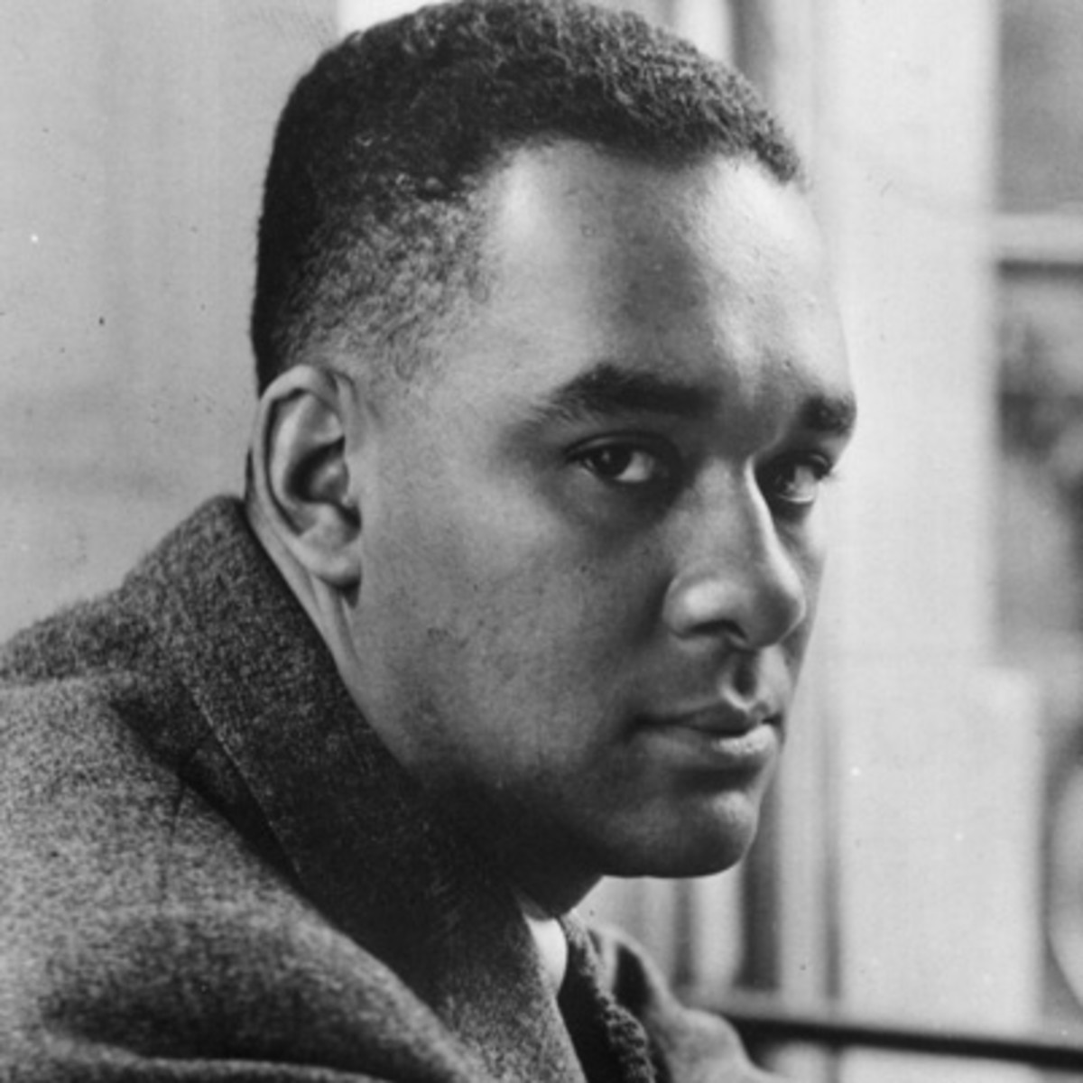

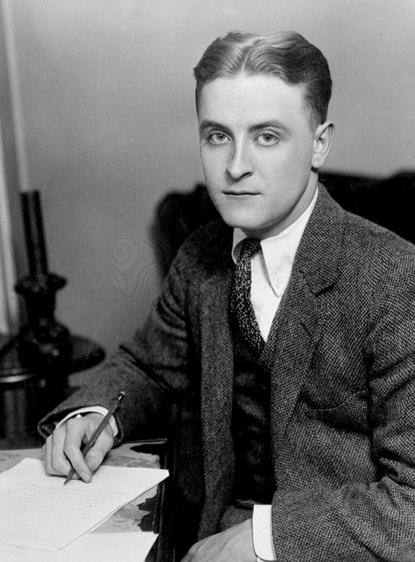
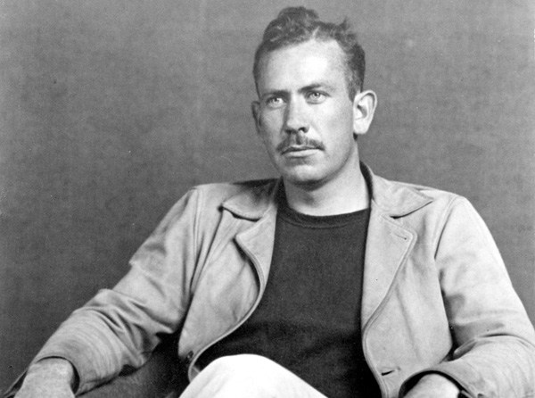
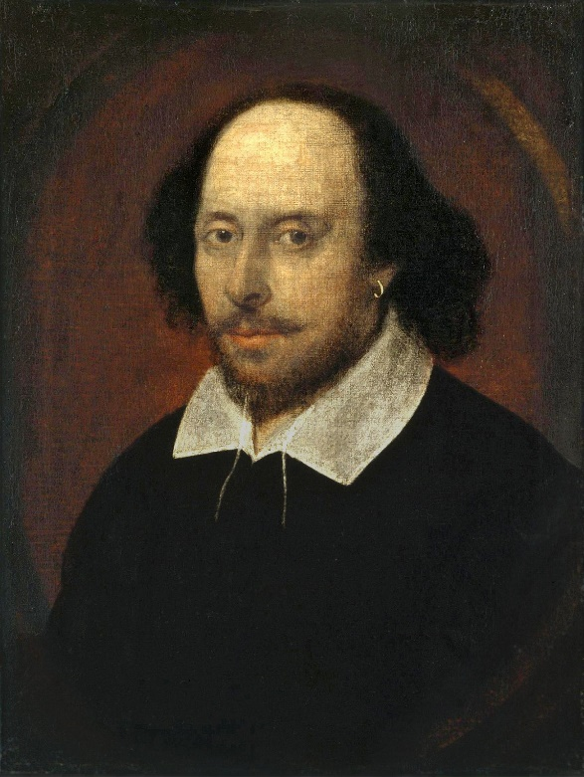
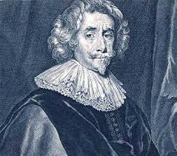
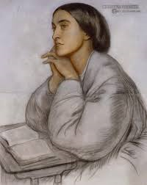

Slide 3
What to expect?
Over the two years you will study prose, plays and poems that all culminate in exams at the end of Year 13. (5 hours worth)
Normally, two teachers and four lessons a week.
Approximately two pieces of written work a week.

Slide 4
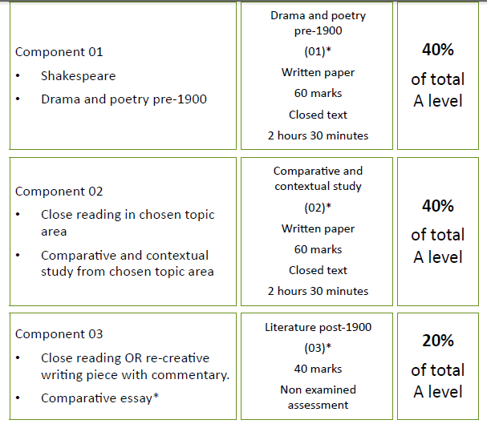
Hamlet,
The Duchess of Malfi &
Christina Rossetti
American Literature 1880-1940
The Great Gatsby
The Native Son
Three texts, based on theme. Two are post 1900 One HAS to be post 2000.

Slide 5
Transition from GCSE to A-Level
Essential skills to develop:
A love of learning and thirst for knowledge: Be inquisitive; ask questions and then be motivated to find out the answers. These might not be in the first place you go to: be prepared to read around and conduct extensive research.
Independent learning: Unlike at GCSE, you will be expected to take responsibility for your own learning with support from your teachers who can facilitate your learning. Think autonomously and respond personally to texts.
Perseverance and resilience: Persist with your A-Level learning even when it seems too difficult or challenging. Nothing worth achieving ever comes easily. You also need to be resilient and thrive on constructive criticism. It will take time to build on your skills from GCSE to achieving the same grades or higher grades at A-Level. Welcome challenges, be inspired by others’ successes to motivate yourself to succeed and act on the advice given to you by your class teacher. The texts you read and the concepts and theories you come across at A-Level will be challenging and you might find this daunting at first, but you will learn a number of strategies to support you in accessing these texts and ways of thinking.
Motivation and Conscientiousness: Learning requires effort and a commitment to your studies. The more you invest in your learning, the more you will gain in terms of academic achievement. Be proactive in your learning journey; complete follow-on tasks to improve your skills; read widely to gain more knowledge; look up definitions in a dictionary and concepts online or in textbooks.

Slide 6
American Literature 1880-1940
You will study two texts in detail, but will also be given one ‘unseen’ extract from a piece of writing during this time period.
What do you know about this time period (strictly in America?)
Mind map everything you already know.

Slide 7
American Literature 1880-1940
Now, using the internet, research this time period more widely.
Can you find any information on?
-The abolition of the Slave Trade and The American Civil War (before this time but so important!)- Watch LINCOLN if you want a different media.
-The ‘Jazz Age’
-Prohibition
-Women in the 1920s
-Automobiles
-The American Dream

