Slide 1
Introduction to Hamlet
A-Level English Literature

Slide 2

What do we study?
Component 1 – Drama and Poetry pre 1900
Hamlet
Christina Rossetti poetry
40% 2 hour 30 minutes exam
Component 2 - Comparative and contextual study
The Great Gatsby
Native Son
40% 2 hour 30 minutes exam
Component 3 - Literature post-1900
A Streetcar Named Desire
Poetry and prose chosen by your teachers
20% 2 written coursework essays

Slide 3

Tragedy
From GCSE, what can you remember about features of tragedy?
Write an extended definition of TRAGEDY that includes at least three of
the following terms (look them up if you need to!):
Hamartia
Hubris
Peripeteia
Anagnorisis
Catharsis

Slide 4
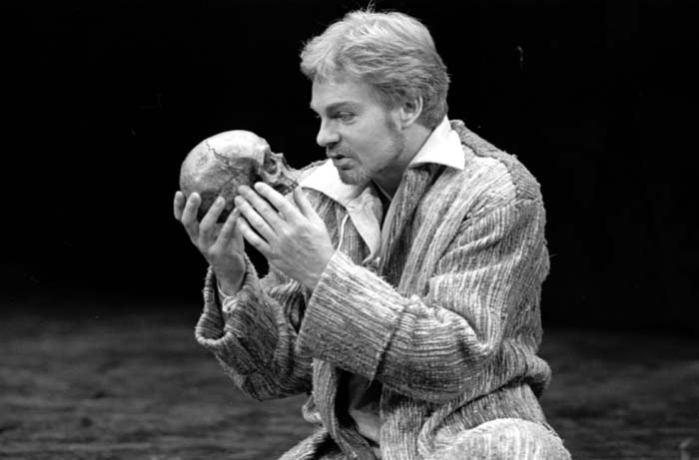
Hamlet Research
Hamlet is arguably one of Shakespeare’s most popular tragedies. Visit the Royal Shakespeare Company website (https://www.rsc.org.uk/hamlet/) and see what you can you find out about:
The plot
Characters
Past productions

Slide 5
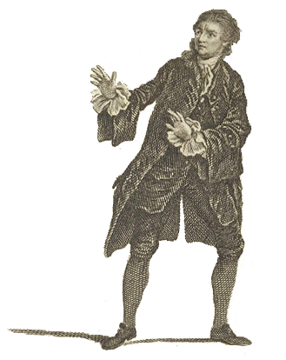
To be, or not to be – An Overview
Have you heard this famous line before? What do you think it means?
This is the beginning of Hamlet’s most famous soliloquy. Read through the attached extract. Underline some of the words of you don’t know and look them up to help your understanding.
Generally speaking, what do you think Hamlet is trying to say? Do not worry if you don’t understand it all at this stage, try to make some comments based on words/phrases that stand out to you.

Slide 6
To be, or not to be – Closer Analysis
Now that you have a broad understanding, annotate your copy of the extract using some of the following prompts to help you.
Select some metaphors and explore their effect
Can you find any patterns in terms of the image choices?
Which words/phrases get repeated and why?
How/where does Shakespeare use rhythm/sound to emphasise key words?
What might be the purpose of the colons and semi-colons?

Slide 7
Hamlet – Optional Further Exploration
The Royal Shakespeare Company have made a production of Hamlet available on BBC IPlayer available for the next few months:
https://www.bbc.co.uk/iplayer/episode/p089zf8r/culture-in-quarantine-shakespeare-hamlet
A key difference between GCSE and A-Level drama study is that, at A-Level, you need to be able to refer to specific productions. Watch the opening few minutes of this performance and make notes on: characters’ tone of voice and body language, stage setting, props and lighting, use of sound and music.

