Slide 1
Certificate in Financial Studies
INTRODUCTION

Slide 2

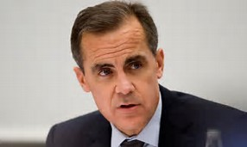
WHAT IS THE COURSE ABOUT?
The course will not make you an instant millionaire.
But it may help you understand the many different ways in which you use your money – for savings, protection, investments and borrowing.
You will not become a qualified Financial Adviser at the end of the course.
But you will have a good background knowledge of many of the financial products on the market, and should be able to asses which is the best for your needs.
You will not instantly become Finance Director of HSBC.
But you may make yourself more employable in both the financial sector and many other sectors as most jobs have an element of finance somewhere.

Slide 3
COURSE STRUCTURE
UNIT 1: Immediate and Short Term | UNIT 2: Medium to Long Term
Topic 1: Purposes of Money | Topic 1: Needs, Wants and Aspirations
Topic 2: Personal Life Cycle | Topic 2: Savings and Investments
Topic 3: Payment Methods | Topic 3: Borrowing Products
Topic 4: Everyday Banking | Topic 4: Dealing with Long Term Risks
Topic 5: Savings Products | Topic 5: Financial Planning
Topic 6: Borrowing Products | Topic 6: Informed Choices
Topic 7: Different types of Providers | Topic 7: Dealing with Unforeseen Events
Topic 8: Consumer Protection | Topic 8: Ethics and Sustainability
Topic 9: Budgets and Forecasts | Topic 9: Sources of Info and Advice
Topic 10: Unexpected Events | Topic 10: Making an Informed Choice
Topic 11: Dealing with Debt
Topic 12: Earnings
Notes:
Fi

Slide 4
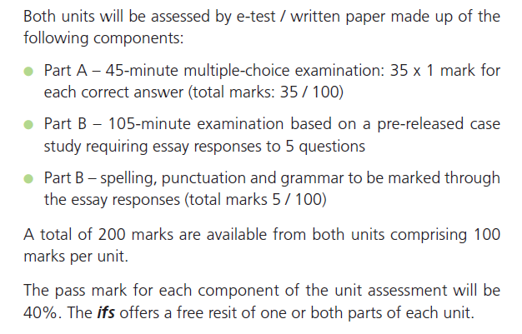
HOW IS THE COURSE ASSESSED?

Slide 5
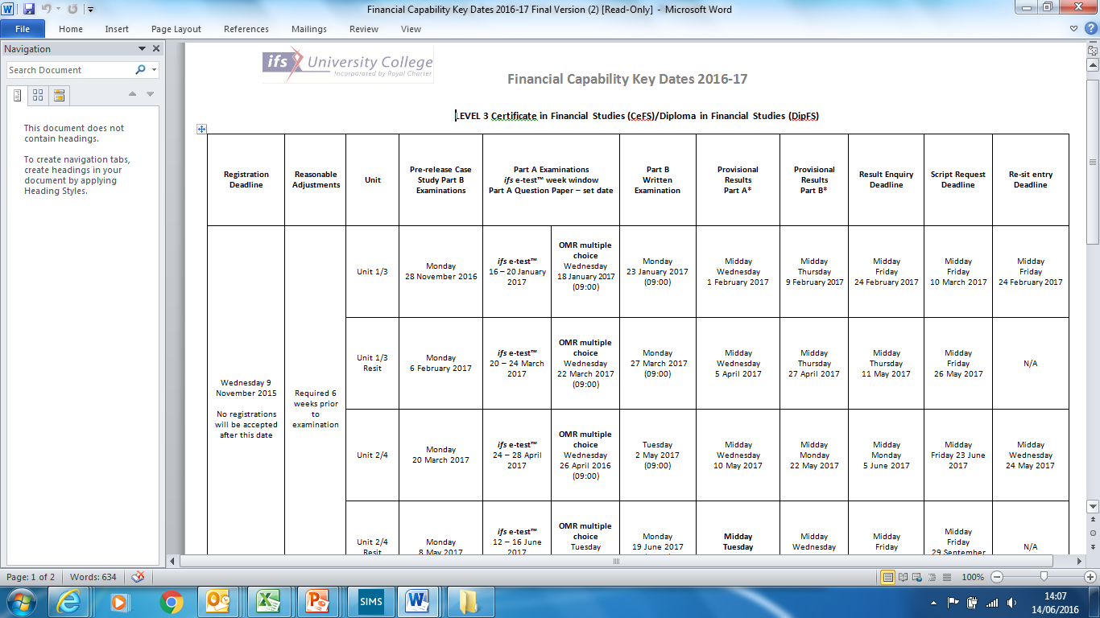
DATES FOR THE DIARY
TO BE ANNOUNCED

Slide 6
CeFS GRADING
CeFS Results
Year 13 – 100% A-C
Year 12 – 100% A-C
% | GRADE | UMS Marks
40 | E | 152
50 | D | 190
60 | C | 228
70 | B | 266
80 | A | 304
90 | A* | 342

Slide 7
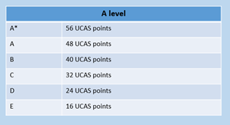
UCAS points

Slide 8

EXPECTATIONS AS AN
A-LEVEL STUDENT
Attend ALL lessons ON TIME
Bring all necessary equipment to EVERY lesson
Complete ALL class tasks to the best of your ability
Complete ALL homework set and submit ON TIME
Read the Topic notes provided (in your own time) which coincide with what you study in lessons
Be aware of up to date current affairs

Slide 9
BUYING A CAR
FINANICAL STUDIES

Slide 10
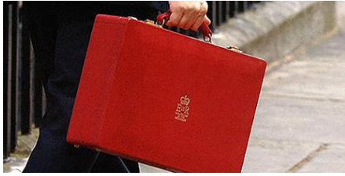

Lesson Objective
To understand budgeting and why people budget

Slide 11
What is a budget?

Slide 12
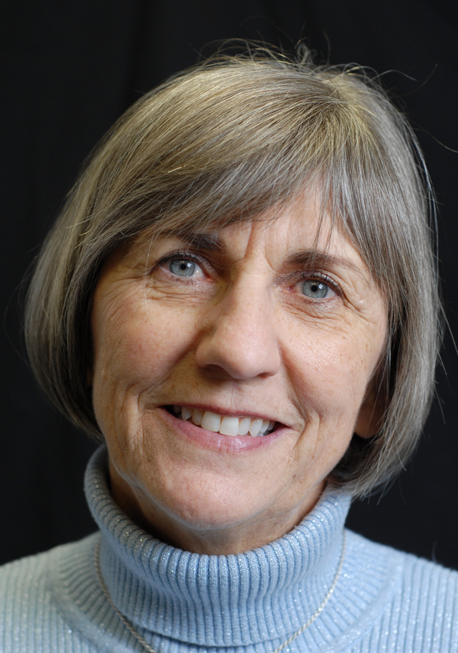

Different stages of the life cycle will result in different needs to budget….Come up with at least 4 ideas for each
Notes:
Ask where the people are likely to get money from…..pension and allowance or pocket money or perhaps a part time job.

Slide 13
Leasing
Insurance cover that gives protection against you injuring another person or damaging their property. E
A sum of money given to a borrower for an agreed period of time at an agreed interest rate. This can be secured or unsecured. A
Third Party Insurance
Loan
An agreed amount is paid every month for the use of a product. The product remains the property of the finance company. F
The amount of money that a product looses over a given time period. B
Third Party Fire and Theft Insurance
Insurance cover that gives protection against fire, theft and accidental damage to you, your vehicle or a third party. C
Depreciation
Insurance cover that gives protection against you injuring another person or damaging their property, or damage to your property caused by fire or theft. G
Fully Comprehensive Insurance
A finance company buys a product you want and then leases it back to you until you have paid off the cost of the product plus interest. The product is then yours to own. D
Hire Purchase

Slide 14


BUDGETING FOR YOUR WHEELS
Read the case study provided. You must make informed choices about how you're going to manage your money
When you purchase your car. You CANNOT over spend!
You need to consider:
Car cost
Insurance
Warranty
Breakdown cover
Tax
MOT
Type of purchase
Autotrader is blocked, therefore you’ll need to be creative.

Slide 15
You are 17 (+ 6 months!) years old and have just passed your driving test. Your generous parents have given you £4,000 so that you can get a car. Within this £4,000 you must cover all the costs of running the car for a year (excluding fuel & servicing)
Use the internet to see what you can get for your money!
Visit www.thisismoney.co.uk/consumer-guides and www.moneysupermarket.com/motoring.
www.autotrader.co.uk and www.exchangeandmart.co.uk might be useful too.
Some questions you might like to consider before making you final choice:-
What factors should you consider when choosing the right car?
What are the advantages and disadvantages of buying a new car?
What is a franchised dealer?
What are the advantages and disadvantages of buying from such a dealer?
Where can you get finance for your car?

Slide 16
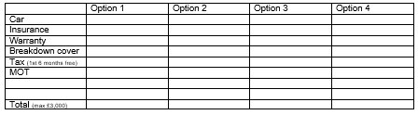
Research – Suggested links on handout.
You should conduct research from a range of websites comparing prices.
Complete the table in your booklet

Slide 17
Questions
Read all the questions. These should all be considerations for you choice.
You should support you choices with an explanation.
Stretch and Challenge
Now if you had a bigger budget and could afford a new car (say £12,000 max) what would you get?
Now visit a main dealer web site, choose a car and obtain a good finance package.

