Slide 1
Getting a job
FINANICAL STUDIES

Slide 2
Lesson Objective
To understand the different personal life cycles

Slide 3
What are the needs, wants and aspirations of a young person?
Needs
Wants
Aspirations

Slide 4

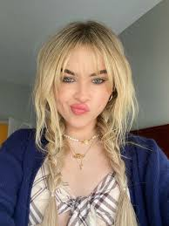
Case Study on Sabrina Carpenter
Sabrina is 19 and is in the final year of the teenager stage of her life cycle. She is in her first year of an apprenticeship in a restaurant called The Cook Kitchen in Sittingbourne. She earns her monthly income but it is not enough for her leave home yet. Next year her salary will increase from £11,000 per year to £16,950 per year and she wants to rent a flat with her friends. She spends most of her money on clothes, shoes and socialising but she is able to save a bit of money per month. She plans to use her savings to pay for items she will need when she moves.
1. As a teenager, what typical events might occur?
2. How much tax would Sabrina pay on the salary she is on now? Would it change when she gets a pay rise? How much is it?
3. What types of unforeseen circumstances can affect Sabrina?
4. Sabrina will have to pay national insurance. What is this?

Slide 5
Answers
1. starting a part time job, school tests/exams, college/sixth form, learning to drive, might leave home, develop stronger relationships with adults outside the family
2. £11,000 is under the £12,750 tax free bracket so no tax
£16,950 is over – so she would pay 20% tax on £4,200 of her salary per year = £840 per annum and £70 per month.
3. Inheritance money, promotion at work, win the lottery, a new career opportunity (maybe singing), health issues or an economic situation (job redundancies)
4. National Insurance contributions are a tax on earnings paid by employees and employers and help to build your entitlement to certain state benefits, such as the State Pension and Maternity Allowance

Slide 6
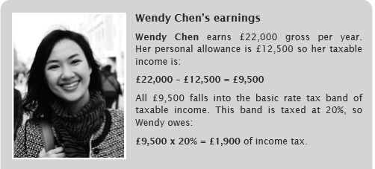
Now practise the Tax calculations – how much tax does Wendy pay?
To calculate how much income tax is owed remember:
subtract the personal allowance from the gross annual income to find the taxable income;
working out which tax band or bands apply to the taxable income;
calculate the amount of tax to be paid using the tax rates for each band.

Slide 7
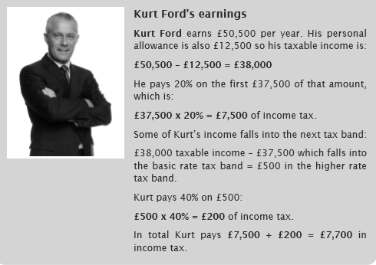
Have another go and remember the steps - how much tax does Kurt pay?
Hint – he uses more bands, as he earns more money

Slide 8
PAYE Documents
What does PAYE mean?
10 mins
What is a payslip?
What is a P60?
What is a P45?

Slide 9
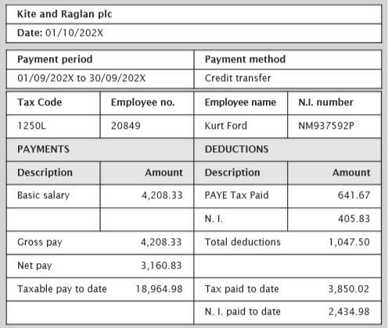
Pay slip – make sure you know how to read one, if your pay is wrong its your responsibility to check!
It shows:
It is used for:

Slide 10
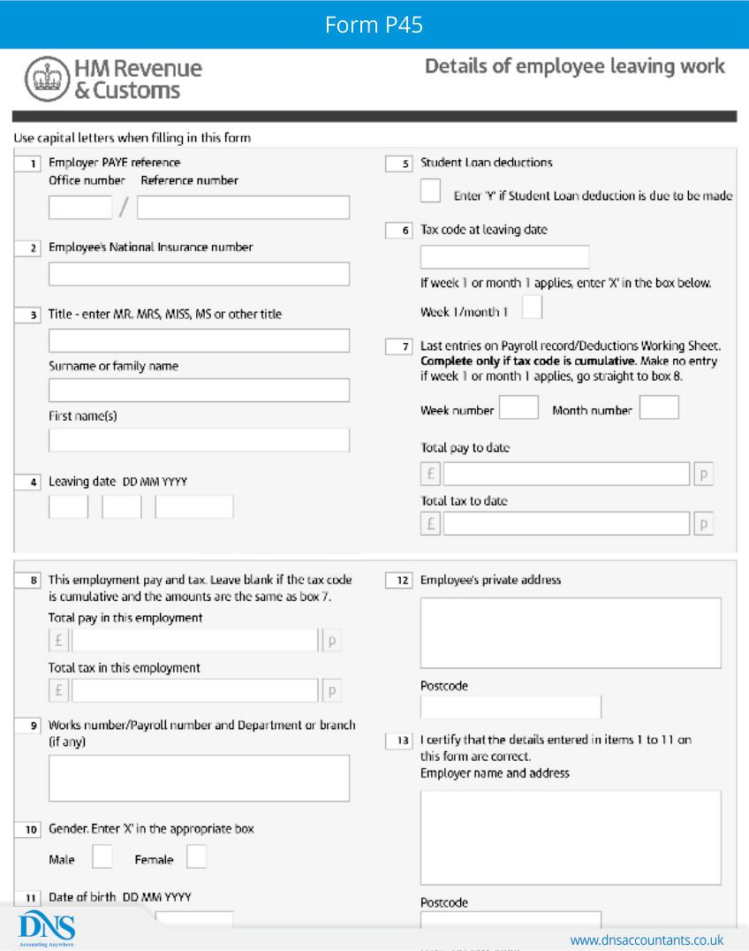
P45– make sure you keep this for a new job.
It shows:
It is used for:

Slide 11
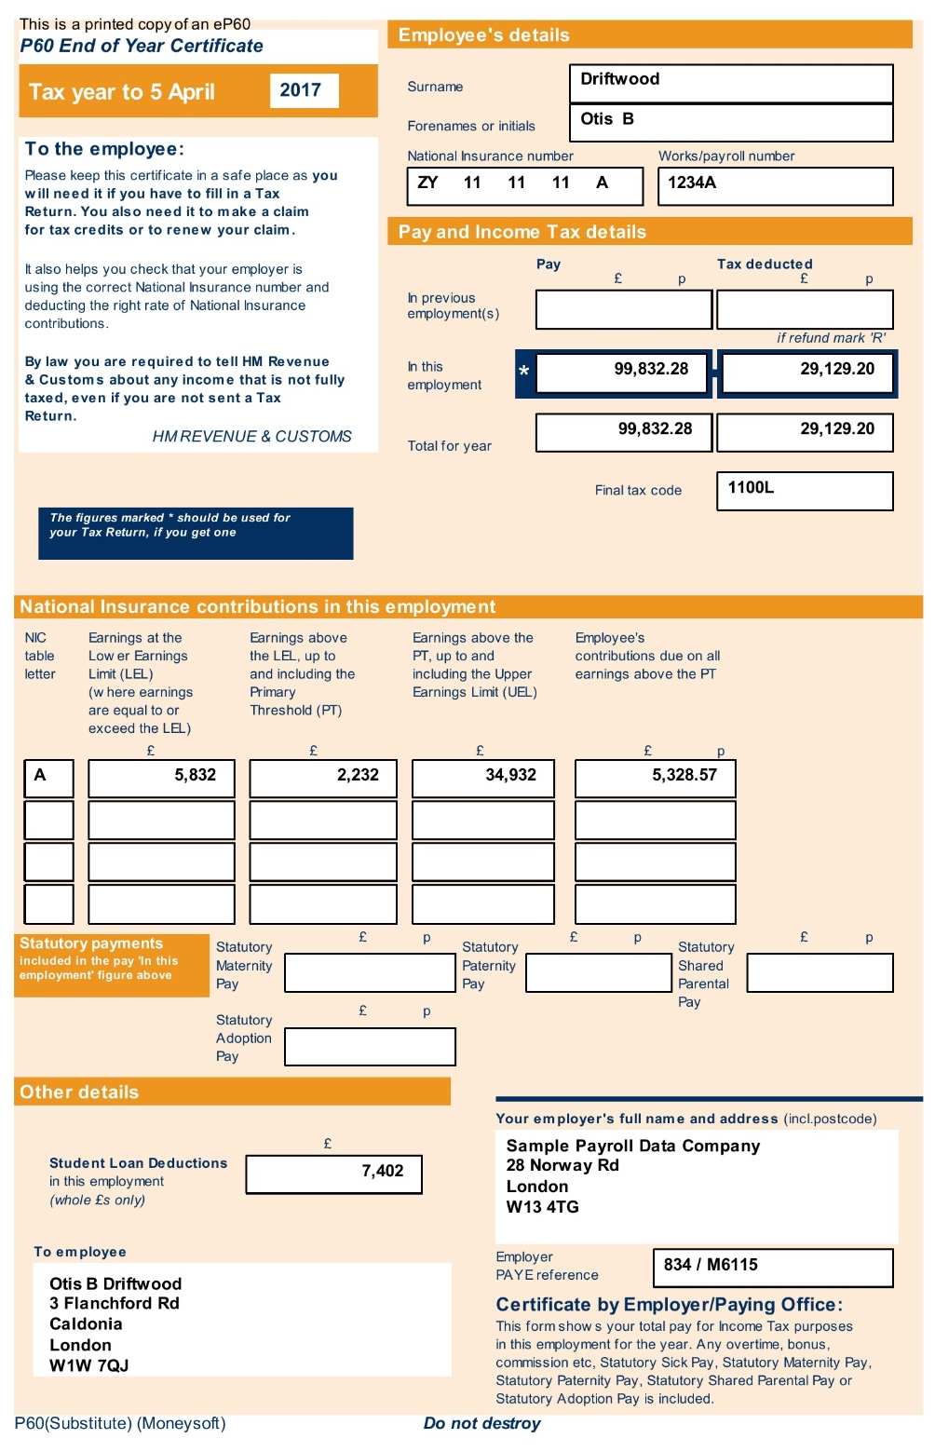
P60– make sure you know keep it if you need to do a tax return
It shows:
It is used for:

Slide 12
Income Tax return & deadlines
Completed by some people to declare the tax to be paid on either their earned or unearned income. For example self employed people or those who have made a gain from savings interest.
Paper returns must be back with the HMRC by the following 31st October, whereas the payment and any online returns must be made by the following January.
So for the Year end 5th April 2020, paper returns must be received by 31st October 2020 and online returns and payments by 31st January 2021.
10 mins
Make a note of the penalties faced by individuals for missing the tax return deadline.
How long should all tax documents be kept for?

Slide 13
Self employed income
Make a note of the extra rule that apply to those self employed.
Why do you think the HMRC enforce this?
Your neighbour knows they need to fill in a tax return because they are self-employed. You know that they do a lot of work ‘cash in hand’ and they’ve asked you what’s the worst that can happen if they get found out.
Take a look at the following article and then reflect on what advice you would give them regarding their tax return.
https://www.dailymail.co.uk/news/article-2226847/Builder-paid-cash-hand-entire-27YEAR-career-jailed-117-000-tax-avoidance.html

Slide 14

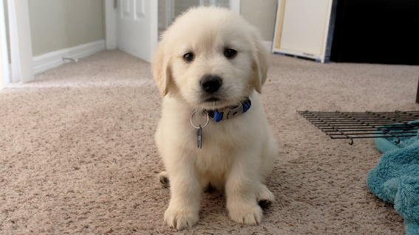
Plenary
Sabrina has left her job at The Cook Kitchen and applied for the X-Factor. Sabrina won the competition and she has become a music star at the age of 22. Sabrina won £3,500,000 for winning the X-Factor competition and a music producer has asked her to fly to America to create a new music album. Sabrina has moved into a new home in California with her mum and dad. Sabrina is now worth a net $4,000,000 and is planning to buy a new dog.
1. How can Sabrina save, invest or spend her money?
2. What does Sabrina need to think about when getting a new dog?
3. If Sabrina was to move to the U.S, what would she need to apply for?
4. What document would Sabrina get from her old job at The Cook Kitchen?

