Slide 1


Going on Holiday
FINANICAL STUDIES

Slide 2
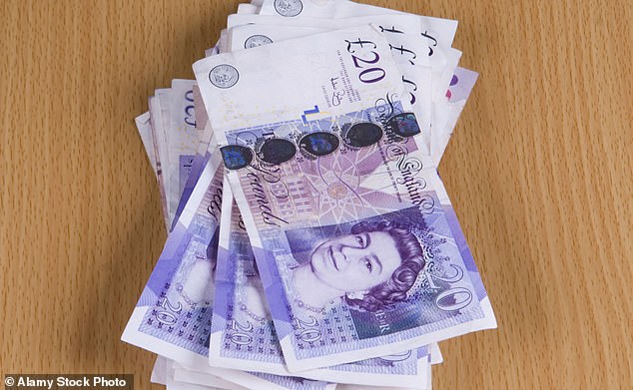
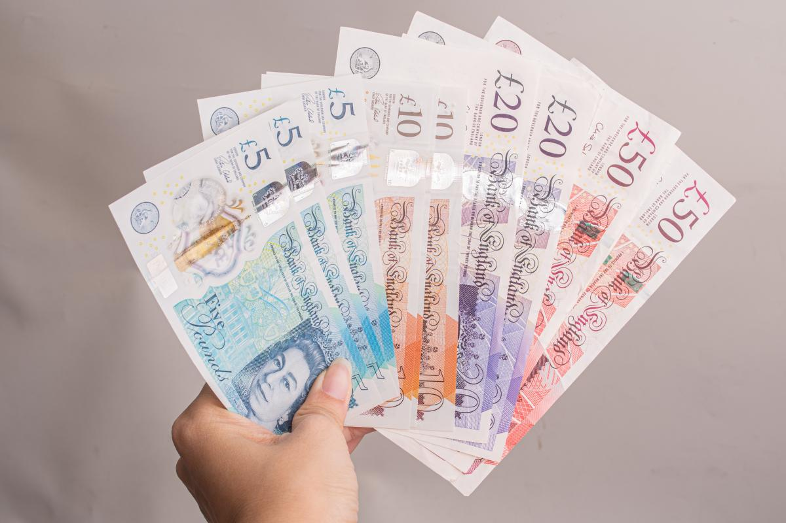
Lesson Objective
To understand the different payment options.

Slide 3
How can a consumer pay for goods and services?

Slide 4
If you were given £200, would you spend it, save it or invest it?
Notes:
Ask where the people are likely to get money from…..pension and allowance or pocket money or perhaps a part time job.

Slide 5
Case Study Exercise
Read the article on the next few slides and then answer the questions.

Slide 6
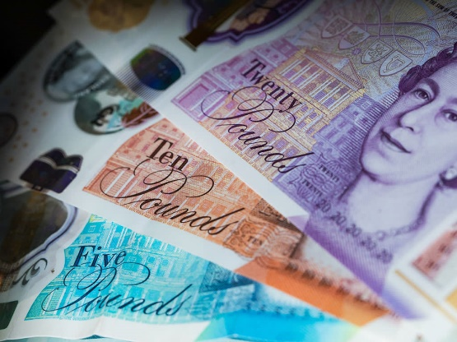
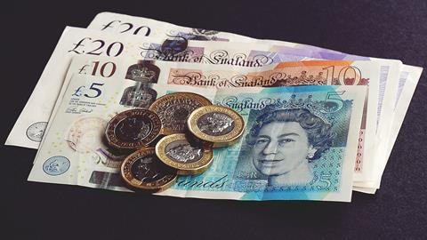
Everything by cash
Mazin, 23, lives in London and is renting a flat that he shares with two friends from university. He is a manager at a local recycling plant and very much enjoys his job.
Mazin has been raised in a family where all payments are made by cash and although he has a Barclays bank account with a debit card, he does not use the debit card for purchases, using it only to withdraw cash. Mazin does not have direct debits or standing orders to pay his bills. Mazin has always been very organised and plans his finances very carefully. He is fully aware of when his bills are due and withdraws cash to pay them at his local Post Office or bank branch. Mazin has never missed a payment that has been due. If Mazin does not have the money to socialise with his friends, he stays in and lives within his means.

Slide 7
Mazin has never used the overdraft his bank offers him; he has never had a credit card or any other form of debt. For Mazin, he appreciates the value of the money he earns and feels that he uses his money wisely.
Mazin does have a savings account with the Post Office. He has been saving towards his goal of going on holiday to the USA, with the two friends he lives with. Mazin has never been abroad before but it has been one of his goals in life to visit New York, Washington and Los Angeles. He has saved £5,000, which is enough for his flights, accommodation and £100 per day spending money while he is away for two weeks.
Mazin has priced up travel insurance from the Post Office as this is the only provider that will accept cash, which insures lost or stolen cash for up to £300. Mazin has also been saving his spare change in a jar in his bedroom for extra cash if he needs it. He is amazed how much he has saved so far, nearly £200.

Slide 8



As Mazin has not been abroad before, he is unsure how he will take his money to the USA. He would like to withdraw the cash in the UK, exchange it all for US dollars and take this with him. However, he is well aware of the risks this carries and has asked you to do some research on his behalf for the options he has.
After he has been to the USA, Mazin wants to start saving for a deposit for a mortgage. He knows this will take a long time, but he has a plan on how to do this.

Slide 9
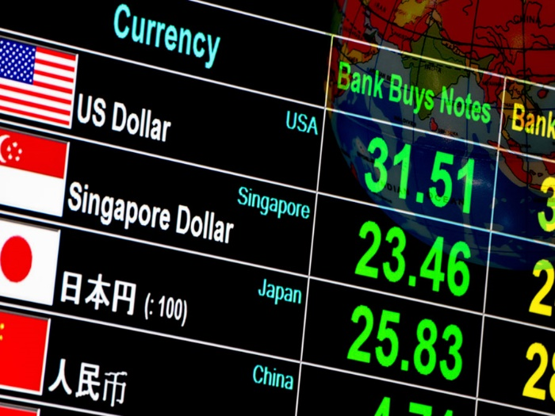
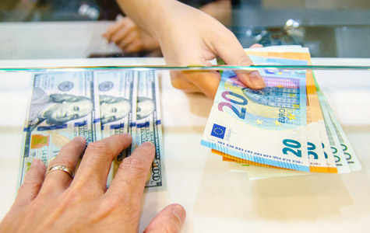
The Research
Buy foreign currency in advance
It's always worth taking a bit of cash with you, so take the time to shop around for foreign currency in advance. The most competitive deals are usually found online and collecting your money from the foreign exchange bureau will be cheaper than having it delivered.
Many companies also charge a commission to exchange sterling into foreign currency, so be sure to factor that in when you're comparing costs. In some cases, you may be offered a commission-free exchange, but be aware the exchange rates may not be as competitive.

Slide 10
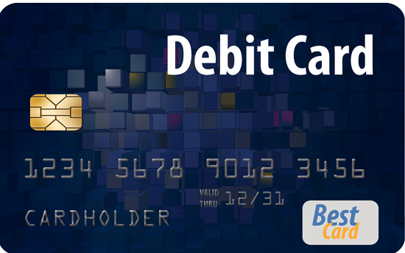
Use the right card
Taking a debit or credit card with you can be a good choice if you don't want to carry around stacks of cash on holiday. But use the wrong one and you could get caught out by expensive fees.
Many cards will charge a foreign exchange fee for overseas use. Often this is around 2.75% to 2.99%, so for every £100 you spend, you could be charged £2.75 to £2.99.
If you do want to take plastic with you, look for a card that's specifically designed for overseas use.

Slide 11
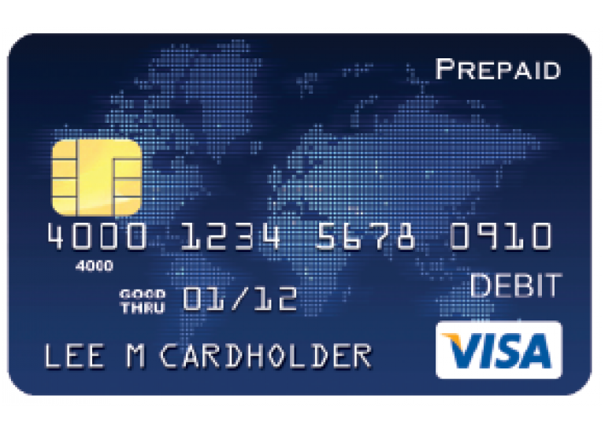
Consider a prepaid card
Another option is to use a prepaid card when you're away.
With this type of card, you pre-load it with a cash amount before you set off (you can top it up with further funds later if necessary) and you can then use it in the same way as a debit or credit card.
Although you may still be charged fees, prepaid cards are often cheaper to use than a standard debit card. What's more, they are ideal if you're on a budget as you can only spend what's on the card.
Typically, prepaid currency cards can be loaded with sterling, euros or US dollars. If you opt for one that can be pre-loaded with sterling, your money will be exchanged into the local currency when you use your card abroad.

Slide 12
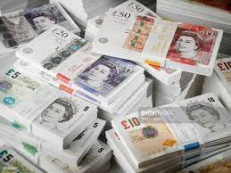
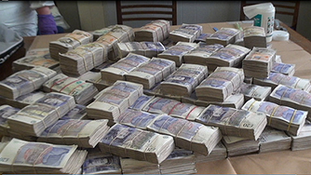
How safe is using cash?
Carrying cash when you’re abroad is never as safe as using cards. Travel insurance will usually only cover you up to a certain amount of cash if it’s lost or stolen.

Slide 13
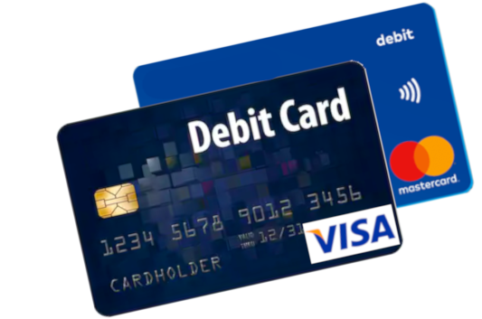
Debit cards abroad
Many people prefer to use cards while they’re away because they’re convenient and they’re accepted around the world.
These are great for withdrawing cash from an ATM and work in much the same way as they do when you use them at home.
To help avoid fraud or card cloning, we suggest you should not let your card out of your sight.

Slide 14
Pros and cons
• Quick and convenient way to withdraw local currency from cash machines.
• You’ll be charged to withdraw money – this usually adds around 2% on the amount you take out and some cards will also add a fee of around £1.50 on top, as well as charging currency exchange costs.
How safe are debit cards?
You’ll be protected against fraud, so if someone steals your card you can claim compensation for any money they spend.

Slide 15
Using pre-paid cards abroad
These are a great alternative – you simply load the card up with money before you go and you’ll be able to spend it to your heart’s content while you’re away.
Pros and cons
• You won’t be able to spend more money than you have on the card.
• If there is any cash left on the card after your holiday, most cards can also be used in the UK.
• You’ll be charged a fee if you need to top-up or withdraw money from an ATM.
• Some cards carry additional charges like a monthly fee, or an extra charge if you don’t use the card within a certain period.
• If you lose your card, a replacement can cost around £5 to £10.
How safe are pre-paid cards?
These cards are growing in popularity as a safe alternative to traveller’s cheques as the money you load onto the card will be protected if it’s lost or stolen.
Plus, the card isn’t linked to your bank account so you can only ever lose what you’ve put on the card.

Slide 16
Barclays debit card Can I use my Barclays debit card when I'm abroad?
Yes, you can use your debit card in millions of shops and cash machines worldwide – anywhere you see the Visa sign.
We'll charge you a 2.75% Non-Sterling Transaction Fee for using your debit card abroad when making purchases, withdrawing cash or when you are being refunded. This fee will also apply whenever you don't pay in sterling (either abroad or in the UK) – eg, when you shop online on a non-UK website.
The Non-Sterling Transaction Fee was previously referred to as 'commission' and 'foreign exchange charge'.
Visa converts transactions into sterling using the Visa Exchange Rate on the day it processes the transaction. This date may be different to the day on which the transaction took place.
When using your debit card abroad, some merchant terminals or cash machines may offer you the choice of paying for your transaction in sterling. If you choose to pay in sterling, the 2.75% Non-Sterling Transaction Fee will not apply, but you should always try to find out what the merchant or cash machine owner’s commission charges are and what exchange rate they are using because, overall, it may be more expensive to pay in sterling.

Slide 17
Prepaid travel card
Revolut
Revolut gives perfect interbank rates on most currencies from Mon to Fri UK time when you spend abroad or exchange pounds in advance in the app (1%–2.5% fee at weekends).
You get a free virtual card which you can use with digital wallets (eg, Apple Pay/Google Pay) but physical cards cost £4.99 for delivery.
Application fee: £4.99 for delivery of physical card Exchange rate: Perfect interbank rates except at weekends
ATM withdrawal fee: None up to £200 per rolling month, then 2% after Currencies you can exchange in advance (locking in the rate): 30 incl euros and US dollars (see FAQs for list) Is my cash protected? Revolut is authorised by the Financial Conduct Authority. Any money you deposit is ring-fenced in a Barclays account, so if there are problems with Revolut, the money's safe.

Slide 18
Questions
1. Discuss the use of only using cash to pay for goods and services like Mazin does.
2. Identify different sites that Mazin could use to find the best travel insurance deal.
3. Explain the impact to Mazin in the future of only using cash and not taking out any form of debt.
4. How much would it cost for travel insurance for Mazin, at his age, to travel to America?
5. Challenge Yourself – Evaluate the two options given to Mazin, the Barclays debit card and Revolut prepaid card, on whether he should go with one or the other. Use the information in the case study to support your answer.

