Slide 1
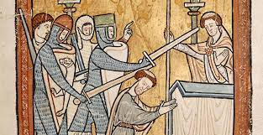
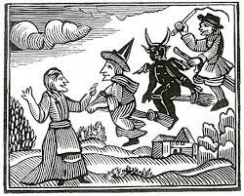
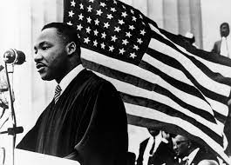
A level history

Slide 2
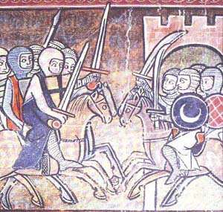
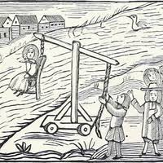
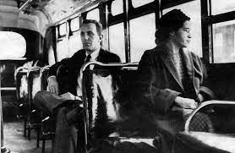
A level history
Well done for choosing A level history!
Over the next two years we will have a great time studying some fascinating events and characters.
We now have the opportunity over these next weeks to do introductory work on our Year 12 topics.

Slide 3
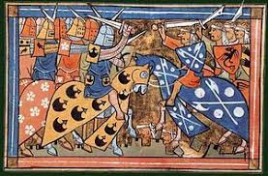
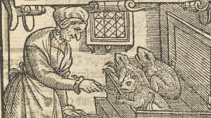
The structure of the course
Y12
Henry II 1154-1189
The Crusades 1095-1204
Y13
Coursework: American Civil Rights
Theme: The witch craze in Britain, Europe and North America

Slide 4
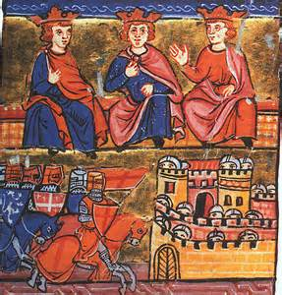
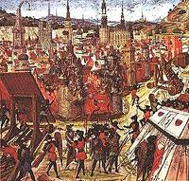
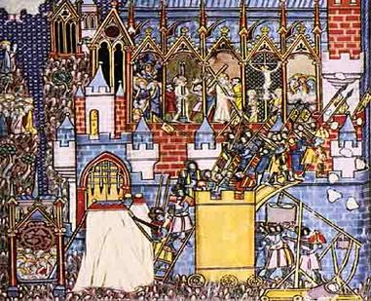
The Crusades
Now let’s make a start on this topic.
You can do your work on paper or on computer. Either way, save it (and this PowerPoint)!

Slide 5
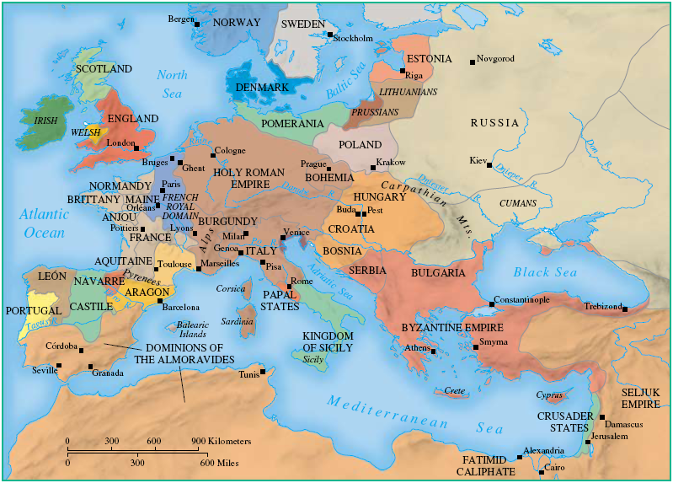
LO: To gain an overview of the Crusades
In one of our units in Y12 we will study the Crusades.
These were a series of wars which stretched throughout the Middle Ages, and were fought between the powers of Europe and those in the Middle East over control of the Holy Land and its capital, Jerusalem.
The Crusades took place here in the Holy Land. The whole region is known as the Middle East.

Slide 6
LO: To use primary sources to gain an overview of the Crusades
What do the following sources tell you about the Crusades? Add your comments around the pictures.
For instance, source 1 on the next slide suggests that a lot of people went, including soldiers, women and children (you’ll see the young person at the bottom of the picture, but the original document has been damaged so it’s hard to make out their head). We can also learn that this group was led by a monk.
(Print off the 5 sources, plus the map on the previous slide, and add them to your work when you can.)

Slide 7
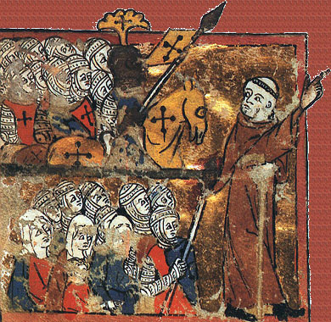
A knight in armour, on a horse
Source 1
The group is led by a monk
A group of women
A young person

Slide 8
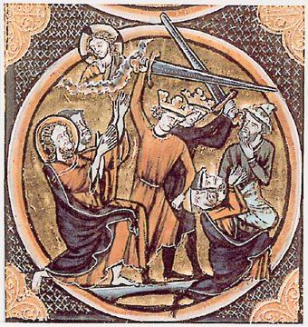
Source 2

Slide 9
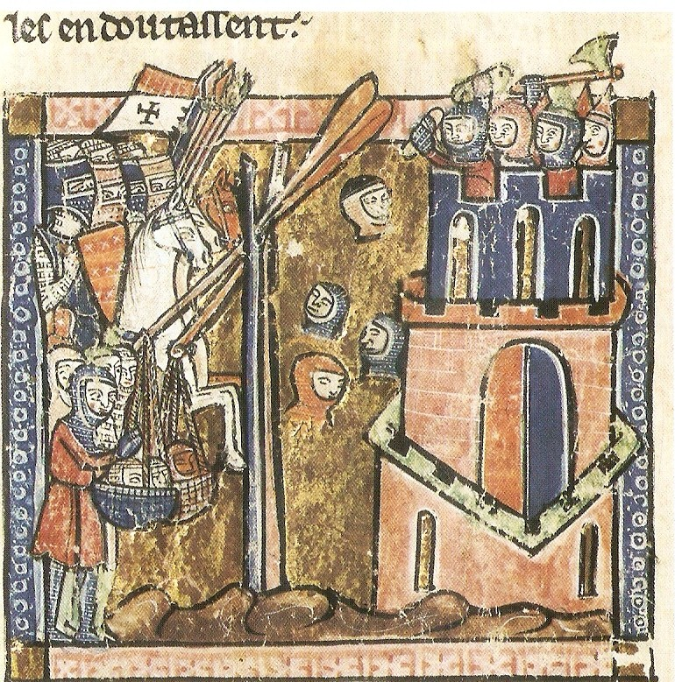
Source 3

Slide 10
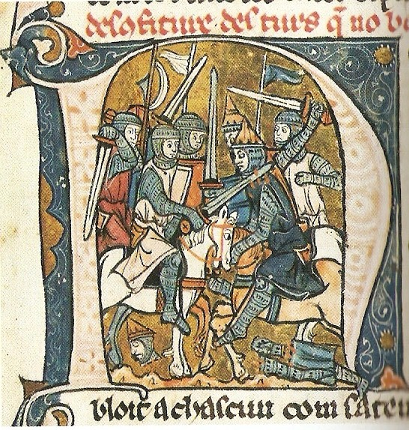
Source 4

Slide 11
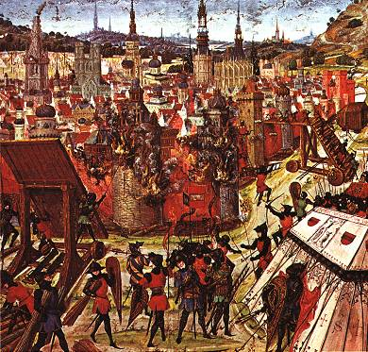
Source 5

Slide 12
LO: To use primary sources to gain an overview of the Crusades
In under 100 words, what do these sources tell you about the Crusades?
What CAN’T these sources tell you about the Crusades? What further questions do you have? What do you want to know? Note these down.

Slide 13
LO: To gain an overview of the Crusades
Next, we’re going to focus on the specifics. Create a fact file on the first four Crusades using the resources on the next slides and your own research. Find out things like:
when the Crusade was
which pope called it
what event sparked the Crusade off
who went and why
what were the main events which happened on that particular Crusade
how successful it was
You can include text and pictures, and present your work as you like.

Slide 14
LO: To gain an overview of the Crusades
 | Dates | Called by Pope… | Causes | Who went + why | Main events | Success/ failure?
First Crusade
Second Crusade
Third Crusade
Fourth Crusade
See the next slide for suggested resources.

Slide 15
LO: To gain an overview of the Crusades
Resources:
https://www.bbc.co.uk/bitesize/guides/zjbj6sg/revision/1
http://www.medievality.com/first-crusade.html
http://www.umich.edu/~marcons/Crusades/timeline/summaries/second_crusade.htm
http://www.medievality.com/second-crusade.html
http://www.umich.edu/~marcons/Crusades/timeline/summaries/third_crusade.htm
http://www.medievality.com/third-crusade.html
http://www.medievality.com/fourth-crusade.html
http://the-orb.arlima.net/textbooks/crusade/crusadesindex.html
https://www.youtube.com/watch?v=X0zudTQelzI

Slide 16
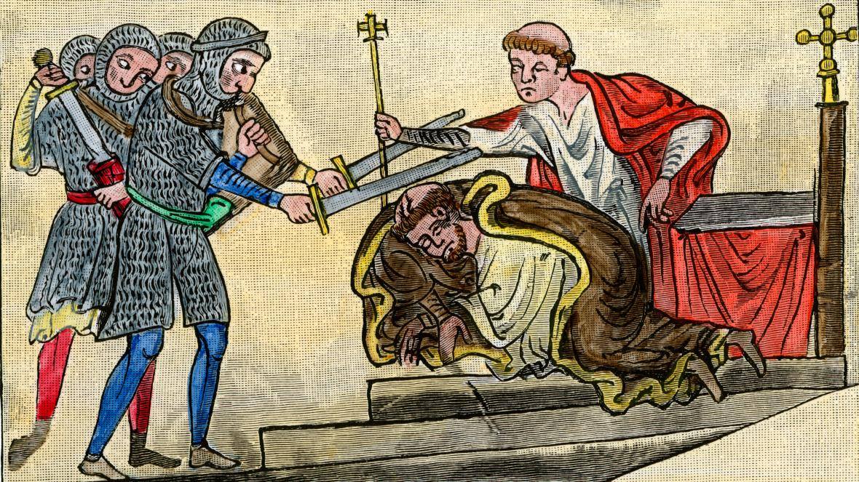
And finally…
Do remember to save your work – whether that’s on computer or paper. What you have studied and learnt are important, and will help you in the future.
I hope you’ve enjoyed part 1 of this introduction to history.
Now you can move on to part 2 – the reign of Henry II.

Slide 17
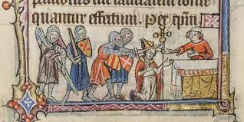
The reign of Henry II 1154 - 1189
The most dramatic and shocking event of Henry’s reign was the assassination of the archbishop of Canterbury, Thomas Becket, by four of Henry’s knights – an act that horrified medieval Europe.
It is one of the topics we will study on the course and the one we will now focus on.

Slide 18
The murder of Thomas Becket
The murder of Thomas on 29 December 1170 was one of the most scandalous happenings of the medieval period. As historians we want to know:
Why did the murder take place…what were the short and long term causes?
Who was involved?
What actually happened?
What were the consequences…for Henry…for the Cathedral at Canterbury…for the Church in England?
Look at the next slide for your choice of task…

Slide 19
The murder of Thomas Becket
Task 1
Either: write your own narrative account of the murder, covering the aspects detailed on the previous slide.
Or: if you are more visual, create a cartoon strip of the murder, again looking at the same issues. (Resource 5 on the next slide will be of interest to you.)
See the next slide for suggested resources.

Slide 20
The murder of Thomas Becket
Suggested resources:
https://www.bbc.co.uk/bitesize/guides/zw3wxnb/revision/1
https://blog.britishmuseum.org/thomas-becket-the-murder-that-shook-the-middle-ages/?_gl=1*48sm7n*_ga*MTc0ODcyMjIzNC4xNjIzMTU1NTAx*_ga_08TLB9R8X1*MTYyMzE2NjcxNS4zLjAuMTYyMzE2NjcxNS4w
http://www.eyewitnesstohistory.com/becket.htm
https://www.historic-uk.com/HistoryUK/HistoryofEngland/Thomas-Becket/
https://www.youtube.com/watch?v=JczRpnjNKwc
https://www.youtube.com/watch?v=FVysavFkXsQ
https://www.youtube.com/watch?v=EfS5I8ZMqEM

Slide 21
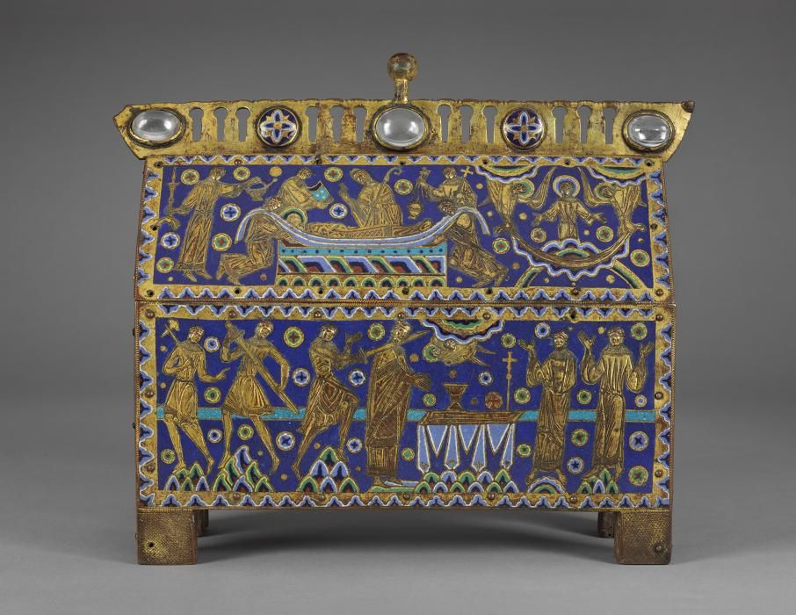
The murder of Thomas Becket
Task 2
Currently there is a fantastic exhibition about the murder of Becket at the British Museum in London. Scroll down to the “Highlights” section on its website: https://www.britishmuseum.org/exhibitions/thomas-becket-murder-and-making-saint
From the 8 images, choose 3 that most interest you and write about them.
Include things such as: what the object is (describe it), what you can learn from it, why it is significant, and why you chose it.
Extension tasks: why not make a visit?
The exhibition at the British Museum is open until 22 August. Why not go?
Closer to home, there is also a Becket event on at the Beaney in Canterbury until 4 July: https://canterburymuseums.co.uk/events/saint-thomas-becket-world-celebrity-healer/

Slide 22
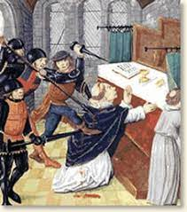
And finally…
Again, do remember to save your work – whether that’s on computer or paper. What you have studied and learnt are important, and will help you on the course.
Do bring all your research into school on our first history lesson.

