Slide 1

Psychology transition Year 11→ Year 12

Slide 2


This ppt is designed to give you an idea of what A-level Psychology is like. In Year 12, you will study the following topics:
Approaches
Research Methods
Social influence
Memory
Attachment
Psychopathology
Have a go at attempting the tasks and experiments over the summer to get a head start and prepare… do not worry if not everything is completed!!
Good luck and most importantly.. Enjoy! ☺

Slide 3

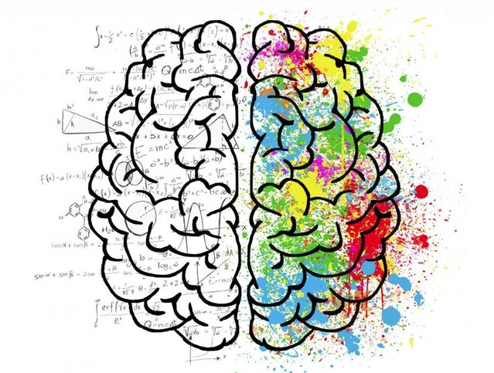
Task 1: Research what psychology is and create your own mind-map or collage about Psychology. Include what jobs you can do with Psychology.
What is Psychology?

Slide 4

Where can I go with Psychology?
Task 2: You should have included some jobs with what you can do with Psychology.
Now I would like you to research one in more detail.. in particular one which looks interesting or something you would potentially like to go into, creating an eye-catching poster of this job.
Look at this website for help: https://www.prospects.ac.uk/careers-advice/what-can-i-do-with-my-degree/psychology

Slide 5
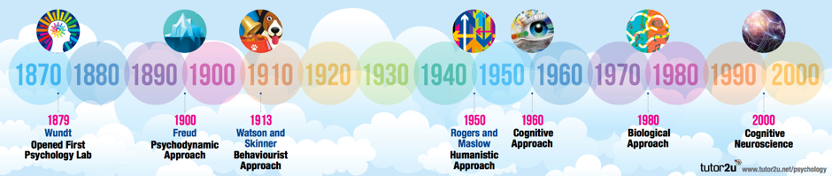
Topic 1: Approaches: the History of Psychology
1960
Bandura
Social learning theory
There are different approaches (perspectives) which emerged throughout history, which explain behaviour in different ways, so why someone is aggressive? Why someone is sad? Why someone is always late to work? One approach: the biological approach says someone is aggressive because of their genes (their biology)
Task: to create your own timeline (like above) and research using the internet the 4 key approaches you will look at in Year 12: the Behaviourist approach, the Cognitive approach, Social Learning theory and the Biological approach.
Find out how these approaches (perspectives) explain behaviour.
Include around your timeline key information about these 4 approaches i.e. key words, key studies, key people.

Slide 6
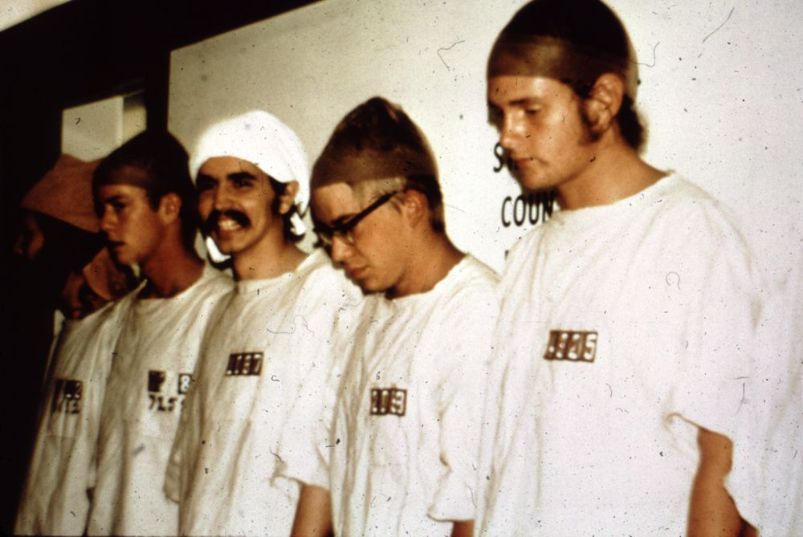
Topic 2: Social influence
Watch this trailer of a film which describes a Psychology study: the Stanford Prison Experiment and write down details about the experiment, for example:
What were the people (participants) asked to do?
What happened in the experiment?
Were any of the results shocking?
Then look at this website for more details:
https://www.prisonexp.org/the-story
Create your own storyboard of this experiment!
https://www.youtube.com/watch?v=3XN2X72jrFk

Slide 7
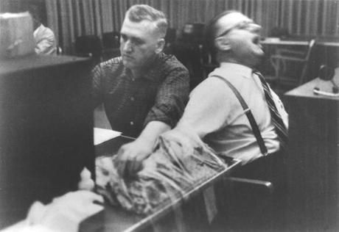
Social influence
Have a think about the question.. Would you obey someone who asked you to give deadly shocks to someone else?
Now watch this film trailer of an experiment:
https://www.youtube.com/watch?v=O1VOZhwRvWo
Task: to summarise this study (Milgram’s experiment) using the video as well as the internet- creating a poster or summary sheet.

Slide 8
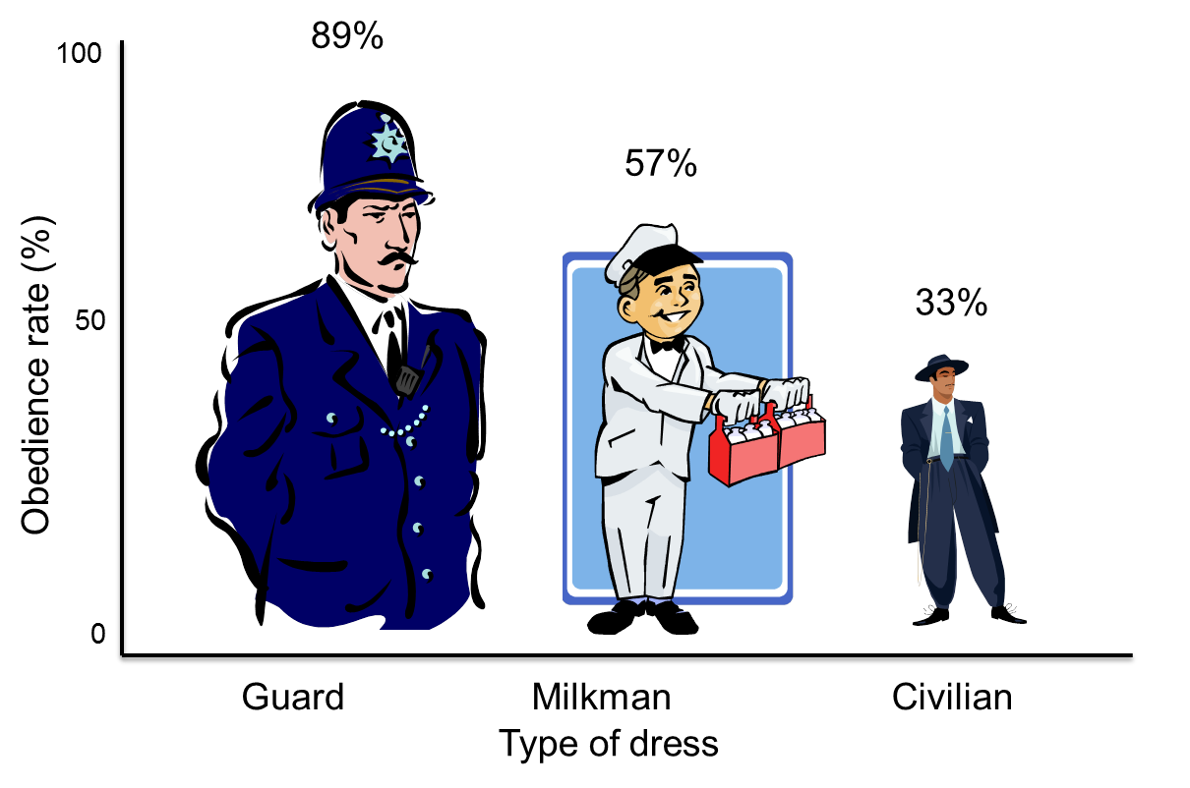
Social influence
Think about the question: who would you obey?
A guard
A milkman
Or a civilian (normal, everyday person)
Now think about why you would obey that person?
Watch these videos for reasons why people obey:
https://www.bbc.co.uk/bbcthree/clip/1885e361-b7a3-40be-9b1d-b7622a37dd77
https://www.youtube.com/watch?v=16QMQXIjYVU
Task to research and make notes/a poster on Bickman’s study about why people obey.

Slide 9
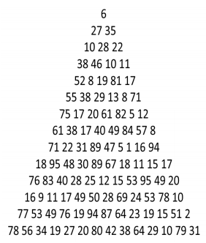
Topic 3: Memory
Experiment number 1:
As the experimenter you should read out one line at a time of the triangle of numbers below to your participant. When you have finished reading out the line, your participant should recite back to you as many of the numbers they can remember.
Record how many numbers they recall correctly on each line. Only read the line once and at the same speed throughout (quite quickly).
The line at which they make their first mistake is their digit span, so if they get a number incorrect or in the wrong order on line 6, stop the experiment and record that as their digit span.
Research what is memory, and are there different types of memory?
What is the capacity (how much information can we hold) and duration (how long can we hold information) of our memory.
To complete an experiment (either facetiming friends or using family in your house):
Now record down all your participants and their digit span, and think about the question:
What do your results suggest about memory? Can we remember many things or not?

Slide 10
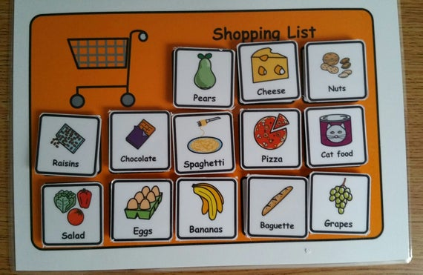
Memory
Experiment number 2:
Again ask your friends and family to memorise this shopping list for 1 minute.
Then ask them to write them down without looking at the list… record down how many items they can remember.
Think about the question: what does this suggest about memory? Can we hold much information in our immediate memory store?

Slide 11
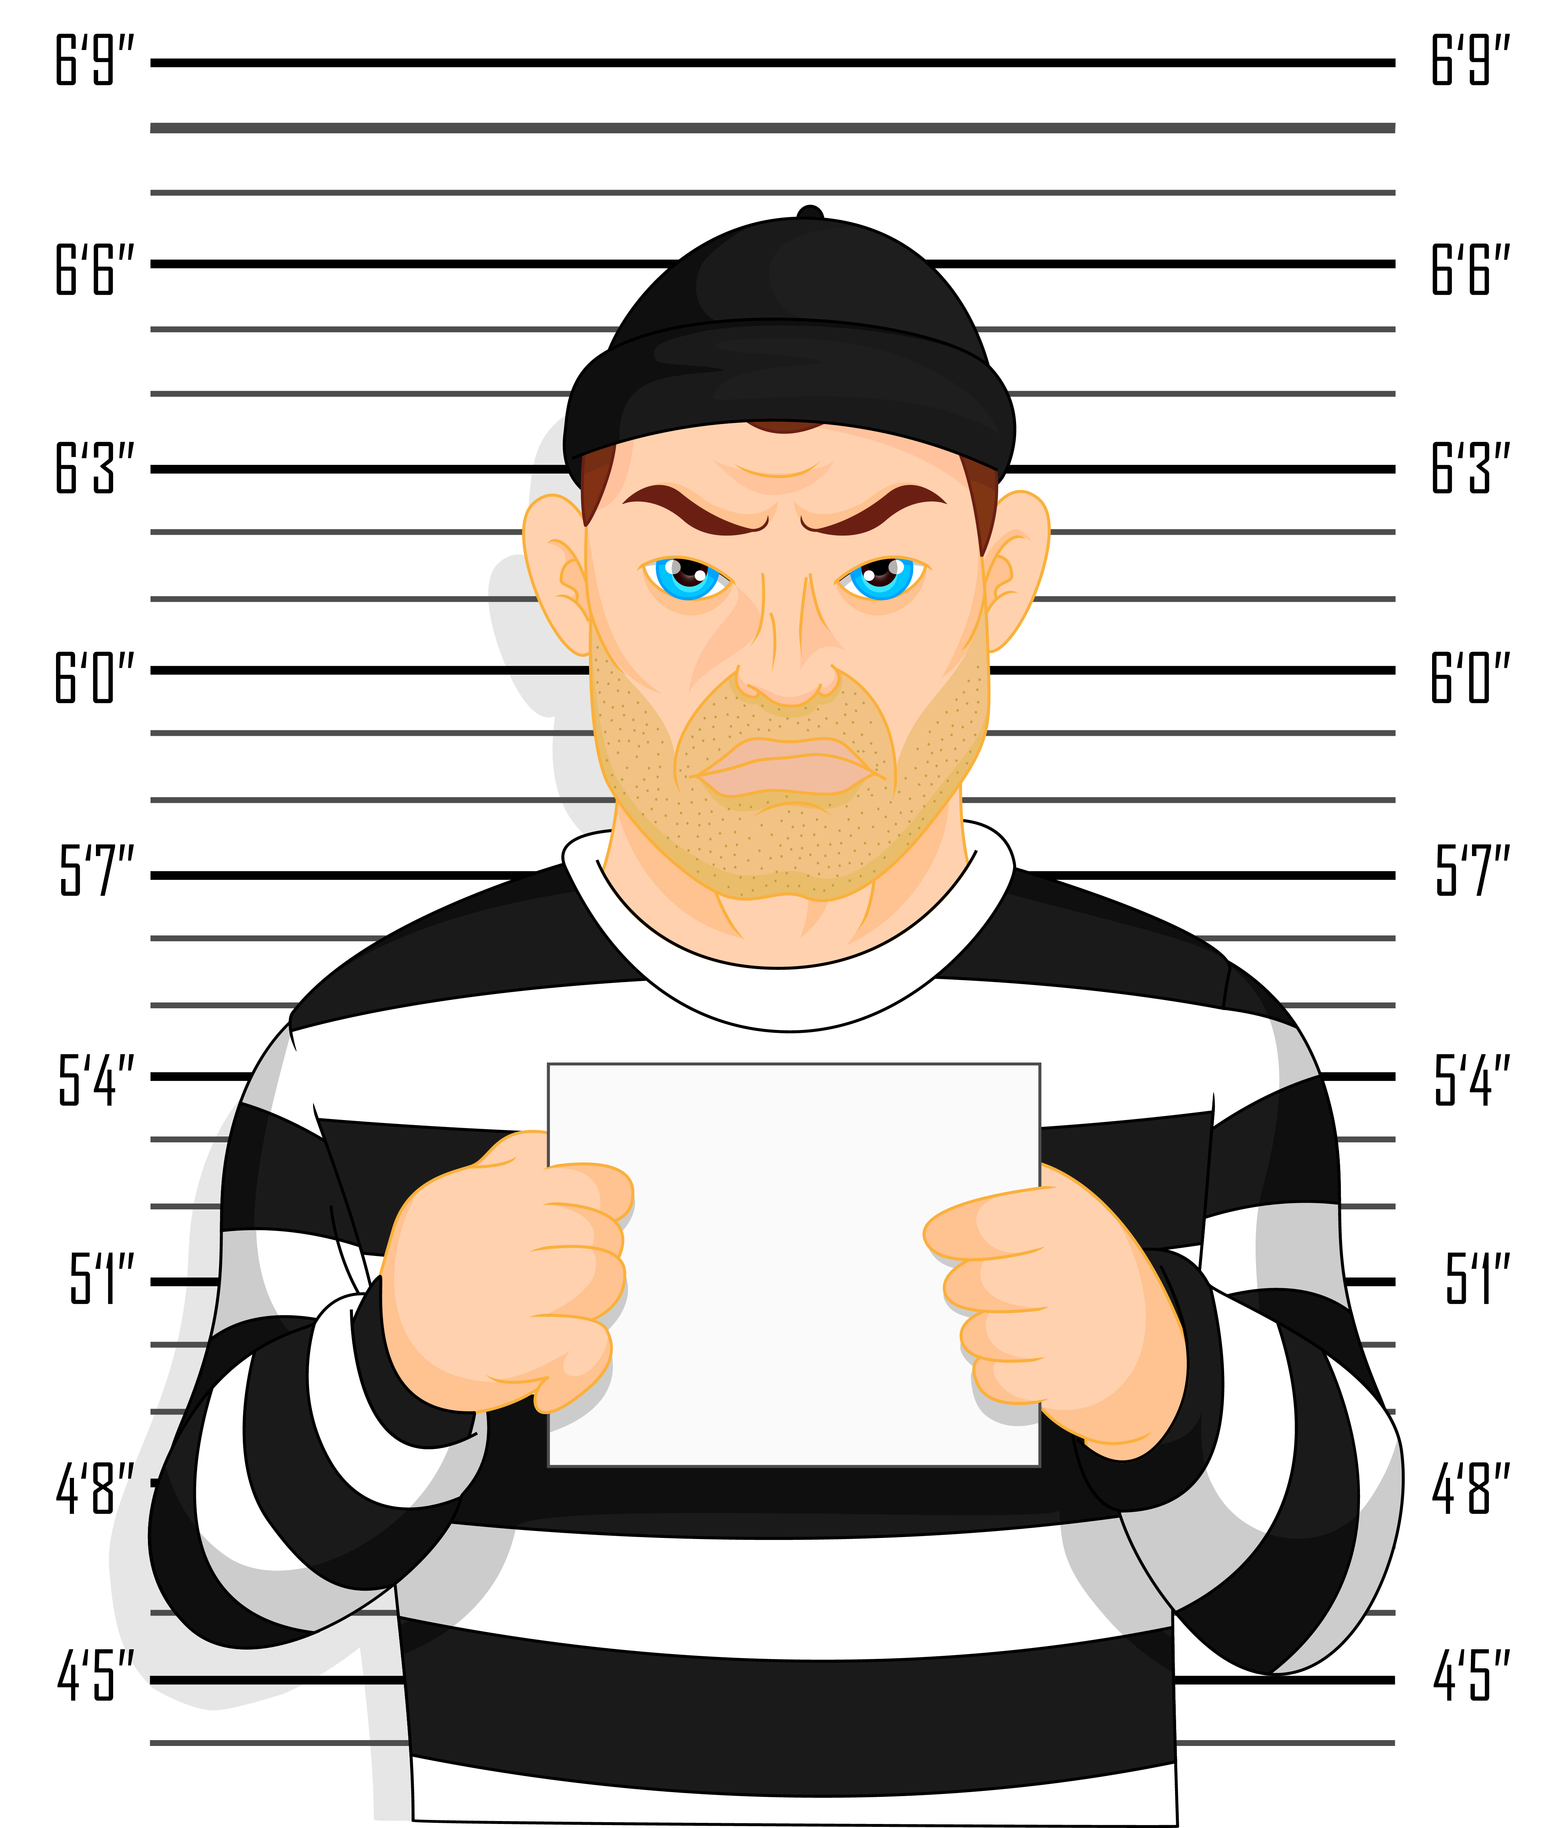
Memory
Research what an eye-witness testimony is.
Then watch this video and see if you can work out the suspect.
https://www.open.edu/openlearn/body-mind/psychology/misidentification-can-you-identify-the-criminal
Write down any information from that video about why we cannot always trust eyewitness testimonies.
Research a key study: Loftus and Palmer, and create a summary sheet linking to why we cannot always trust eye witness testimonies.

Slide 12

Topic 4: Attachment
Write down a definition of attachment.
Do you think it is possible for a child to survive without having formed an attachment? Explain your answer.
Do you think attachment between a child and their caregiver (someone who looks after them) is different across the world or not?

Slide 13
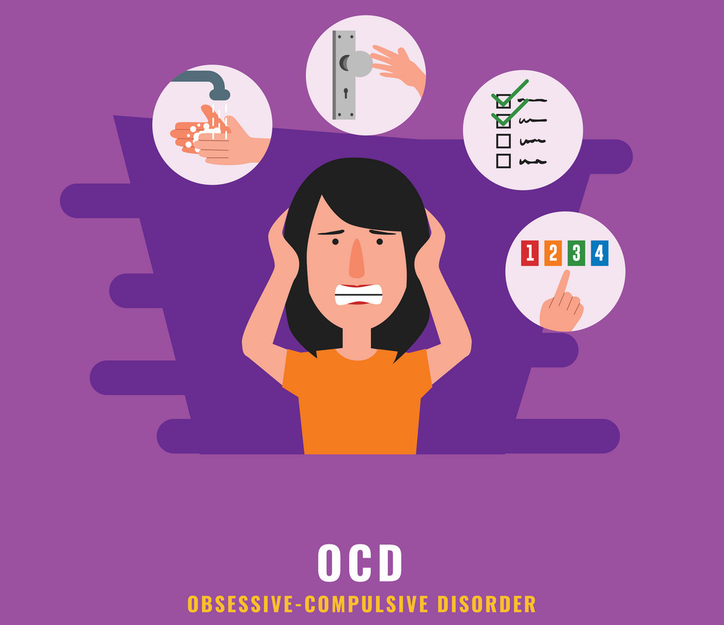


Topic 5: Psychopathology
Research about one of these psychological disorders:
Depression
OCD
Phobias
Create your own pamphlet/leaflet, think about including:
the symptoms an individual may show (what behaviour they might show)
types of the disorder (i.e. types of phobias or examples of phobias)
how many people in the UK have these disorders
how we can treat them.

Slide 14


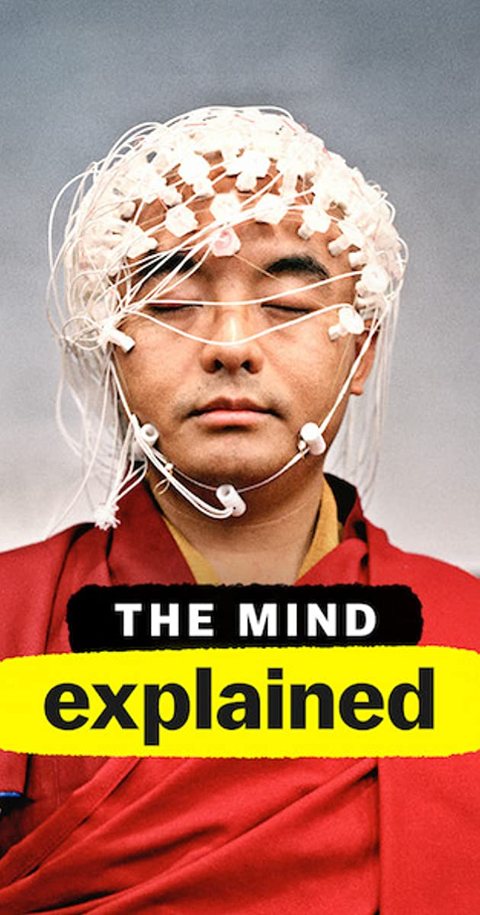

Optional:
Films/series to watch:
Or maybe you have watched a cool film/series which is related to Psychology? Then let us know! Send me any recommendations: gmuir@fulstonmanor.kent.sch.uk

Slide 15




Optional:
Books to read:
Again maybe you have read a cool Psychology-related book? Then let us know! Send me any recommendations: gmuir@fulstonmanor.kent.sch.uk

