Slide 1
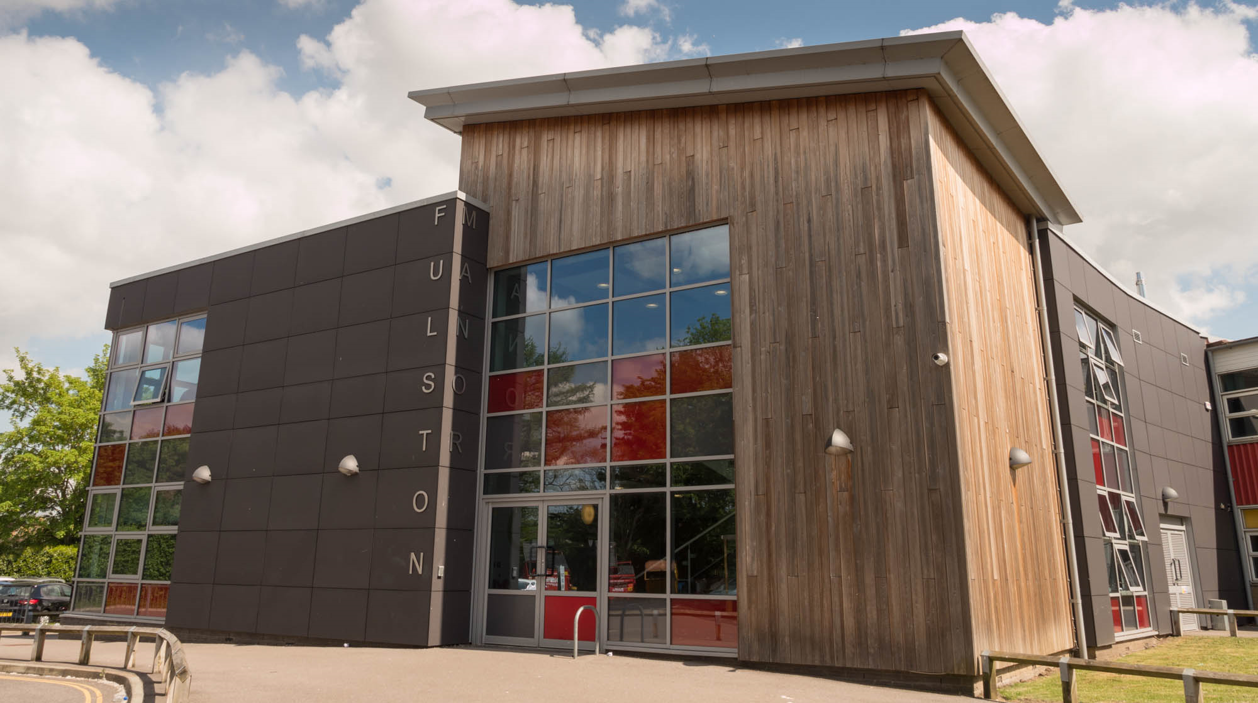

Fulston Manor School
Parent Consultation on Relationships and Sex Education

Slide 2
Common Principles
We all want what is best for children
We want to protect children and to keep then safe
We want children to be healthy and happy
High quality delivery of RSE is part of this

Slide 3
Parent Consultation Session content.
Why the curriculum is changing
Why is RSE in School important
Statutory Guidelines
  Relationships Education in Secondary school
  Physical Health and Wellbeing in Secondary school
  Overview of Teaching Expectation Secondary School
Whole School Approach RSE Policy
Support for Parents and Carer: RSE guides

Slide 4
Why the Curriculum is changing
Today’s children and young people are growing up in an increasingly complex world and living their lives seamlessly on and offline. This presents many positive and exciting opportunities, but also challenges and risks. In this environment, children and young people need to know how to be safe and healthy, and how to manage their academic, personal and social lives in a positive way.
•The Children and Social Work Act 2017 introduced a new legislation on Relationships Education, Relationships and Sex Education, and Health Education in Schools.
•Safeguarding Children is at the heart of Relationships and Education

Slide 5
Why is Relationships and Sex (RSE) Education in School important?
High quality RSE helps create safe school communities in which students can grow, learn, and develop positive, healthy behaviour for life, and for the following reasons:
RSE plays a vital part in schools fulfilling their statutory duties to protect and safeguard their students. Ofsted is clear that schools must have a preventative programme that enables students to learn about safety and risks in relationships.
Schools maintain a statutory obligation under the Children Act (2004) to promote their students’ wellbeing and under the Education Act (2002) to prepare children and young people for the challenges, opportunities and responsibilities of adult life. A comprehensive RSE programme can have a positive impact on students’ health and wellbeing and their ability to achieve, and can play a crucial part in meeting these obligations.
Technology is evolving at a tremendous pace. The need to protect children and young people from inappropriate online content, cyber-bullying and exploitation is a growing concern. A comprehensive RSE programme can support in addressing these issues.

Slide 6
Why is Relationships and Sex (RSE) Education in School important?
Relationships education will be compulsory for all primary age pupils from September 2020.
•Relationships and Sex education (RSE) will be compulsory for all Secondary age pupils
•Health education will be compulsory for all pupils in all state funded schools.
•Teaching at school will complement (NOT REPLACE) and reinforce the lessons families teach their children as they grow up.
•At Fulston we aim to flexibly and inclusively deliver any content in a way that is age and developmentally appropriate with respect to the backgrounds and beliefs of pupils and parents while meeting the aim of providing students with the knowledge they need of the law.

Slide 7
Relationships and Sex Education (RSE) in Secondary schools.
The aims of Relationship and Sex Education is to give young people the information needed to develop healthy, nurturing relationship of all kinds, not just intimate relationships.
Effective Relationships and Sex Education does not encourage early sexual experimentation but teaches young people to understand human sexuality and respect themselves and others. Knowledge about safe sex and sexual health remains important to ensure young people can make safe, informed and healthy choices as they progress to adult life. Students should also be given opportunities to understand how healthy relationships can benefit their own mental wellbeing and self respect.
RSE in secondary school includes learning around families, respectful relationships including friendships, online and media, being safe, intimate and sexual Relationships including sexual health.

Slide 8
Relationships and Sex Education (RSE) in Secondary schools.
There should be opportunity for students to learn about the laws surrounding sex, sexuality, sexual health and gender identity which should be delivered in an age and developmentally appropriate and inclusive way.
The laws around a variety of other issue should by considered which include: marriage, consent, pornography, radicalisation and gangs.
There should be also be opportunities to learn about grooming, sexual exploitation and domestic abuse which should include addressing coercive and controlling behaviour. The physical and emotional damage that can caused by female genital mutilation (FGM) should be addressed.

Slide 9
Physical health and mental wellbeing in Secondary Schools
Students should be taught to make well informed, positive choices for themselves that seek to support their own health and wellbeing. There should be opportunities for teaching students about problems and challenges, including more serious mental and physical health conditions such as substance and alcohol misuse, with a focus on providing information about effective interventions. Schools may also choose to teach about issues such as eating disorders.
Teachers should also demonstrate awareness of common adverse childhood experiences such as students and influence how they experience these subjects. Students should be taught how to judge when they or someone they know needs support and where they can seek help if needed.

Slide 10
Physical health and mental wellbeing in
Secondary Schools
Relationships and Sex Education (Secondary) | Physical Health and Mental Well Being (Secondary)
Families | Mental Wellbeing
Respectful Relationships including Friendships | Internet Safety and Harms
Online and Media | Physical Health and Fitness
Being Safe | Healthy Eating
Intimate and Sexual Relationships including Sexual Health | Drugs, alcohol and tobacco
 | Health and Prevention
 | Basic First Aid
 | Changing Adolescent Body

Slide 11
SRE integrated into Fulston Manor
PDC Curriculum
At Fulston Manor School Relationships and Sex Education will be delivered through the school’s Personal Development Curriculum .
•The Relationships, Relationships and Sex Education and Health Education Statutory Guidance (2019)( alongside Preparation for Adulthood Outcomes –PfA) was used to develop the content of Get Real Curriculum Strands.
•All Schools must have regard to the Statutory Guidance and where they depart from those parts which state what schools should or should not teach, they will need to have good reasons for doing so.
•At Fulston Manor School RSE curriculum content and outcomes are embedded in the following identified curriculum strands:
•Physical Development and Wellbeing,
•Social and Emotional Development and Wellbeing,
•RSE Curriculum Content is spread across a sequence of milestones and will be taught by the school teachers and where appropriate outside visitors and professionals.

Slide 12
Whole School Approach
All of these subjects should be and are set in the context of a wider whole school approach to supporting students to be safe, happy and prepared for life beyond school.
For example, the curriculum on relationship and sex should complement, and be supported by, the school’s wider policies on behaviour, inclusion, respect for equality and diversity, bullying and safeguarding.
At the heart of Relationships Education, Relationships and Sex Education and Health Education, there is a focus on keeping children safe and the role that school can play in preventative education.

Slide 13
Relationship and Sex Education Draft Policy
A draft Relationship Sex Education and Personal Development Curriculum Policy has been written to reflect current statutory guidance including Relationships Sex Education curriculum offer.
Our Draft RSE policy in line with RSE Guidance 2020 include information on
Aims
Statutory Requirements
Delivery of RSE and PDC
Areas of responsibility
Parents’ right to withdraw
Training of staff
Monitoring arrangements of RSE and PDC

Slide 14
Support for parents and carers
DfE has produced guides for parents of primary and secondary aged children which can be used by schools to communicate how relationships and health education will be taught. The guides provide details of topics that will be covered and information of parent’s rights to withdraw. (DfE, 2019c).
•You may access relevant guides following the link below https://www.gov.uk/government/publications/relationships-sex-and-health-education-guides-for-schools
•These are also accessible on the School Website.

Slide 15
What happens next
We will be consulting with Staff, Parents/Carer, Students, Governors in order to inform our draft Relationships and Sex Education and Personal Curriculum Policy. The consultation period opended from Monday 28th of June and closed on Friday 16th of July.
We hope, as parents/carers you have the confidence that we are providing the highest quality education for your children. As a school community we are committed to working in partnership with parents so your views are appreciated.
After the consultation process, teaching staff will begin to design creative lessons plans of which we are carefully considering resources that will safely and subtly address all topic and areas.
Thank you for taking the time to read our consultation documentation.

