Slide 1
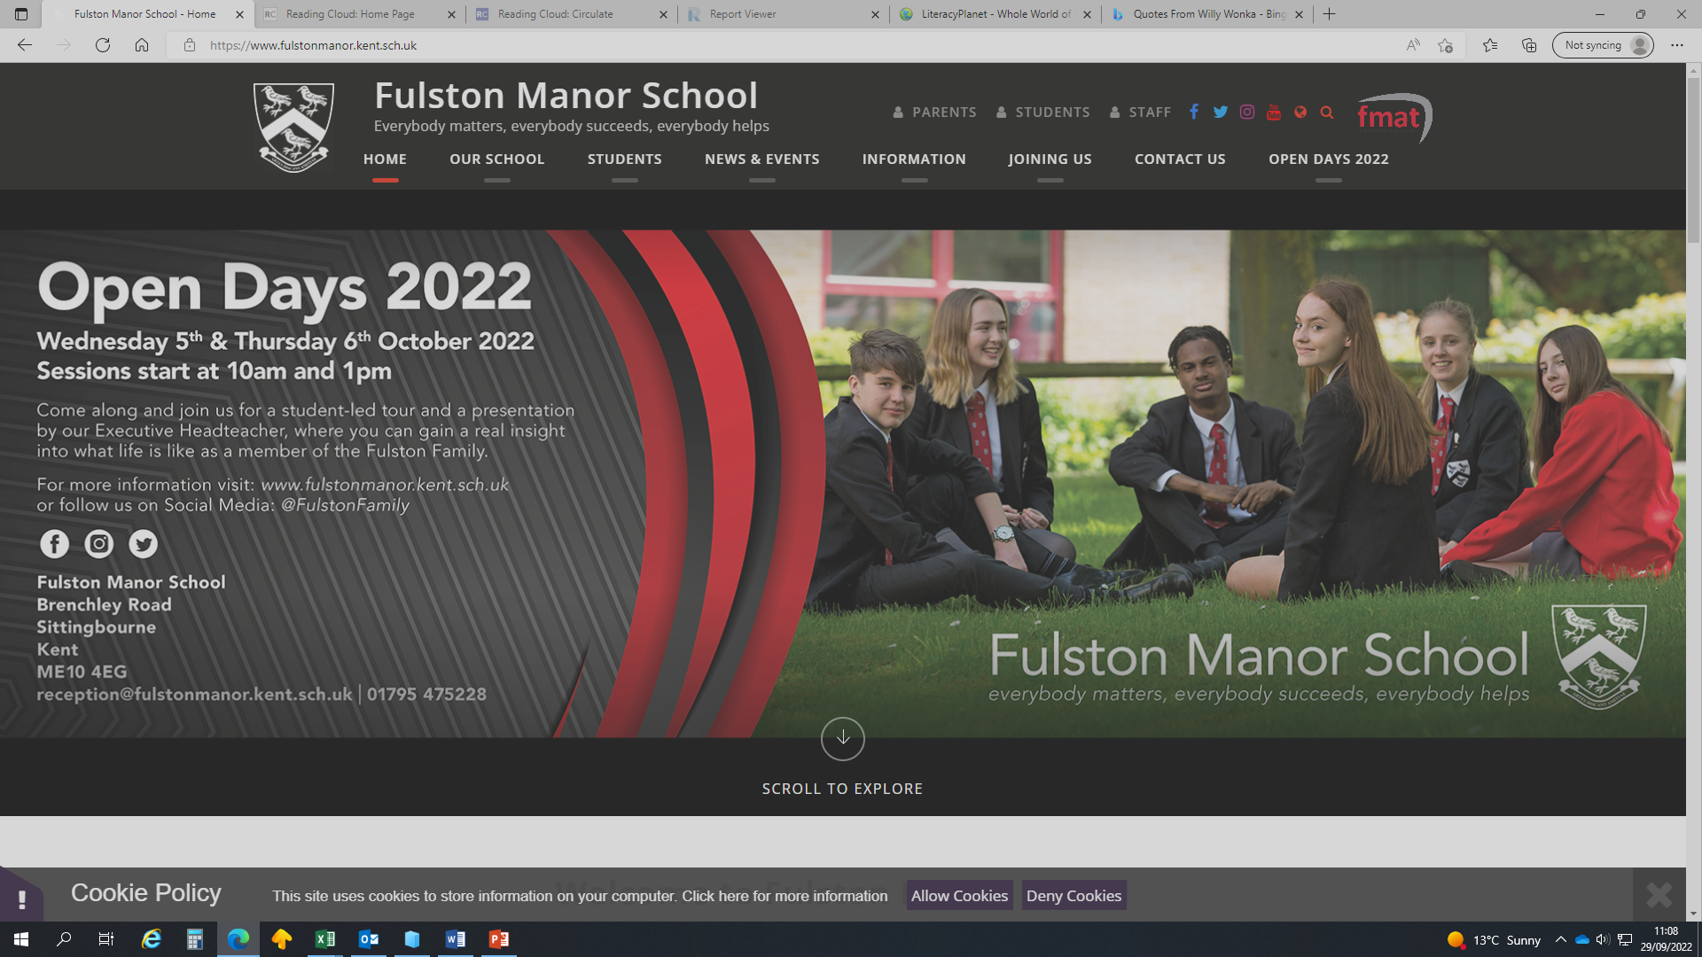
LITERACY

Slide 2
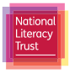
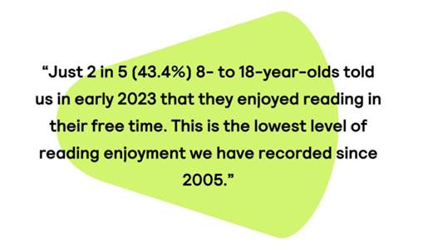
Some facts about literacy
From the National Literacy Trust
In 2021
  51.5% of children and young people said they enjoyed reading.
  30.1% of children and young people said they read something daily.
  44.6% of children and young people agreed that reading made them feel better.
Poor literacy can have lifelong negative impacts
  Not reading at the expected level puts children at an increased risk of experiencing unemployment and poor health as adults.
  Strong reading skills have been shown to improve children’s academic attainment across a range of subjects.
September 2023…

Slide 3
Recap of some of the research…
At least 40% lack the vocabulary to access their learning.
Word gap is increasing between Year 7 and Year 11.
A strong correlation can be made between the number of words a child comes in contact with, on a daily basis, and the breadth of their vocabulary
The size of a child’s vocabulary is the best predictor of success on future tests.
Children with poor vocabulary at five are four times more likely to struggle with reading in adulthood & three times more likely to have mental health issues.
Strong correlation between reading ability and GCSE attainment across the curriculum.
Impact on pupils
Lower self esteem
Less likely to stay in education
Negative impact on behaviour
More difficulty making friends
Worse school attendance rates
Greater difficulty getting work after leaving school
Difficulty working independently
Difficulty following what is going on in class
Worse results in National Tests (eg. SATs, GCSEs, and Scottish national qualifications)
Slower than expected progress in English
Slower than expected progress in other subjects

Slide 4
Moral Purpose
Developing pupils’ literacy isn’t only about helping them to do better in their exams.
It is also about moral purpose…literacy levels are strongly associated with a wide range of social, economic and health benefits.
Improving pupils’ reading is likely to be an investment in their long-term wellbeing and happiness.
https://researchschool.org.uk/greenshaw/news/the-challenge-of-developing-reading-at-secondary-school

Slide 5
35% of year 7 students, last year, joined the school with a reading age below 10.
GCSE examination questions are written with a reading age of 15 yrs & 7 mths (average).

Slide 6
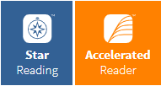
How we try to improve literacy
Accelerated Reader
Using Accelerated Reader in year 7 and 8 we;
Assess reading ages
Test comprehension
Reward reading
Students should always have their AR book with them at school for English and Period 5.
Students are asked to quiz on 2 or 3 books per half term.

Slide 7






Accelerated Reader
What reading should your child be doing?
We ask that each student aims to read and quiz on 2 or 3 books per term, that suit their ability.
Choosing the right book is important, to ensure there is enough challenge, without the book taking too long.
We will be working hard during term 1 to help year 7 students find books they will enjoy reading.
If you have books at home, you can check if they are AR books at:
AR Bookfinder UK & Ireland
Barrington Stoke for dyslexic / reluctant readers
Variety of genres and authors for confident readers

Slide 8
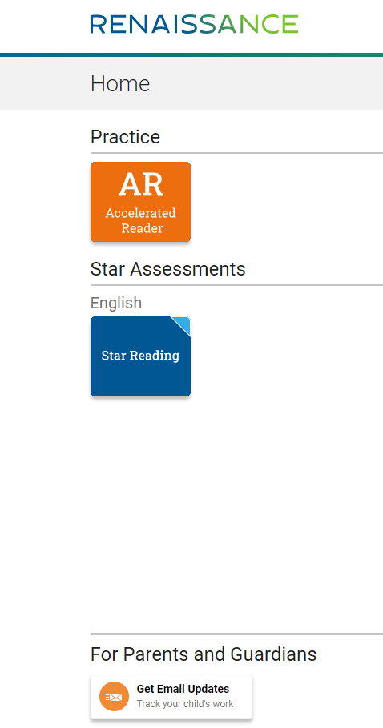
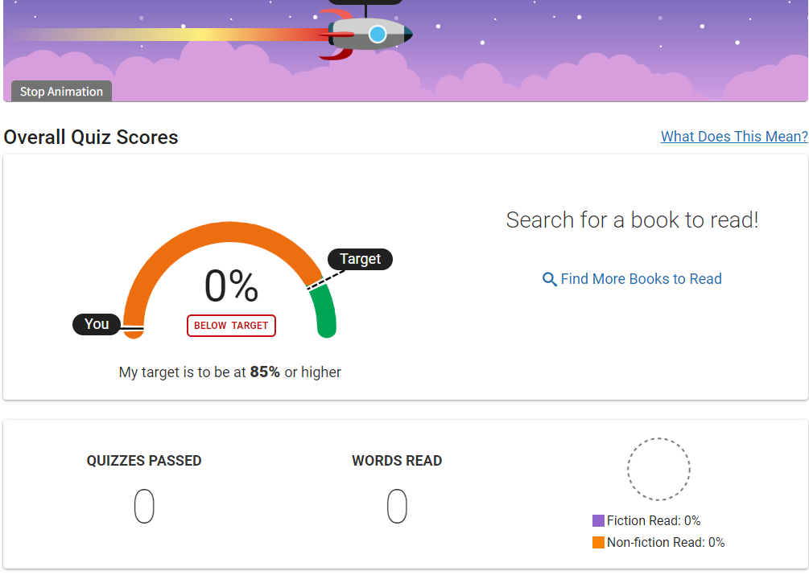
Accelerated Reader
How can I see what my child is doing?
Email Alerts – If your child logs in to AR at home, at the bottom of the screen is a button - Get Email Alerts. If you follow this link and complete the form, you will be sent an automated email when your child quizzes on a book.
HomeConnect – In the Parents drop down menu on the school website, there is a link to Renaissance HomeConnect Login. Here you can see quizzing data across the year. Use your child’s username and password.

Slide 9




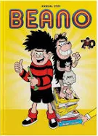

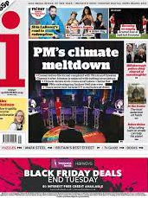
Additional Reading
In addition to an AR book, we would encourage students to read as widely as possible. This may include;
Magazines
Newspapers
Recipes
Comics
This will improve vocabulary.

Slide 10
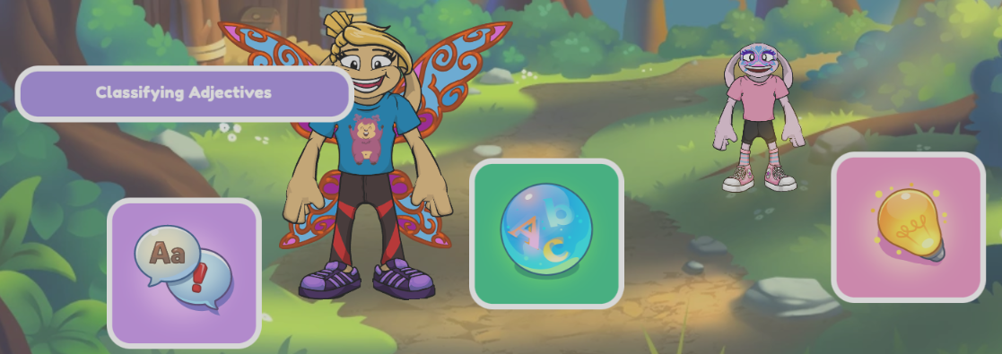
How we try to improve literacy
LiteracyPlanet
LiteracyPlanet is an interactive programme that helps to improve spelling, grammar and comprehension.
It can be differentiated to suit each child’s reading ability.
Students are currently expected to complete at least 10 missions a fortnight, and this is set as homework.

Slide 11
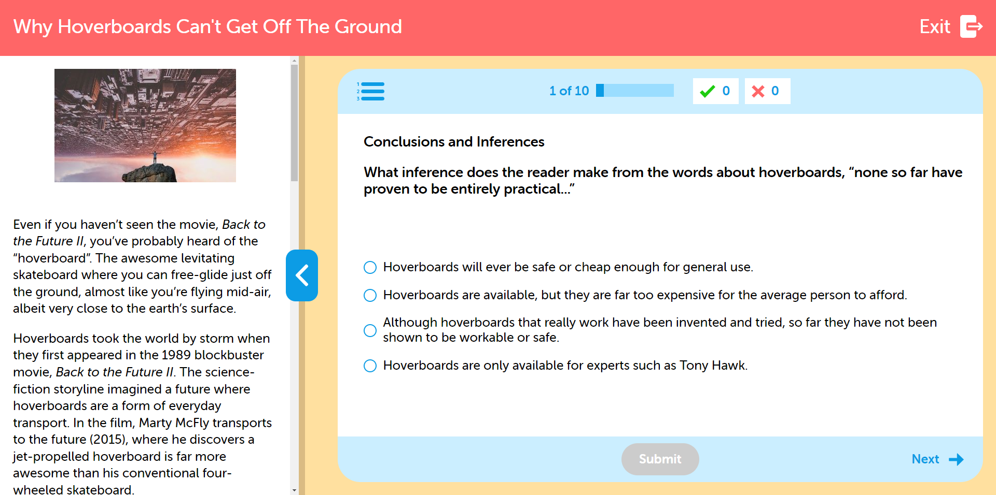
Literacy Planet is designed to challenge students and stretch their vocabulary.
For students to gain the most benefit from this, they will need to actively engage with the programme. This means:
Reading comprehension texts thoroughly
Doing practice modules within grammar and spelling missions
Doing 5 missions per week properly
This is the English homework during year 7

Slide 12
How parents can help
Continue to read with and to your child. If your child does not like reading, being read to is helpful.
Encourage your child to read regularly.
Encourage your child to actively engage with LiteracyPlanet.
  This may mean:
  looking up the definition of words.
  Writing spellings that they are struggling with.
  Doing practice modules

Slide 13
The Results
  Last year, students who engaged fully with both Accelerated Reader and LiteracyPlanet demonstrated improvements in their reading ages by up to 3 years.

